Slide 1
Day2, Bulk RNA-seq & ChIP-seq
NIEHS Workshop--Analyzing NGS data
https://github.com/zhuy16/NIEHS_NGS_Workshop
July 14, 2021
9am-2pm
Yunhua Zhu, PhD
zzhonghua@gmail.com
Computational Genomics Specialist, Transcriptomics
Medical Science & Computing

Slide 2
Agenda -- day 2, bulk RNA-seq and ChIP-seq
Part II, Bulk RNA-seq
9:00-9:15AM, connect to biowulf
9:15-9:30AM, introduction to bulk RNA-seq
9:30-10AM, From Fastq files, alignment with RSEM, Tophat
10AM-10:30AM, Visualize the output using IGV.
10:30-11:00AM, Normalization and differential analysis with DESeq2
Questions and break
Part III, Chip-seq
11:30AM-12PM, Introduction to ChIP-seq analysis
12:00-12:15AM, Alignment to genome using Bowtie2
12:15-12:45AM, Use MACS2 to call peaks, and use Diffbind to call differential peaks
12:45-1:15AM, Use CEAS to annotate peaks and summarize statistics.
1:15am -1:45AM, Use Homer to study TF binding site analysis. And use GREAT for gene ontology.
Review & Summary

Slide 3
Install software to visualizing alignment results
Install IGV on your local machine
https://software.broadinstitute.org/software/igv/download
Install IGM on your local machine
https://www.bioviz.org/

Slide 4
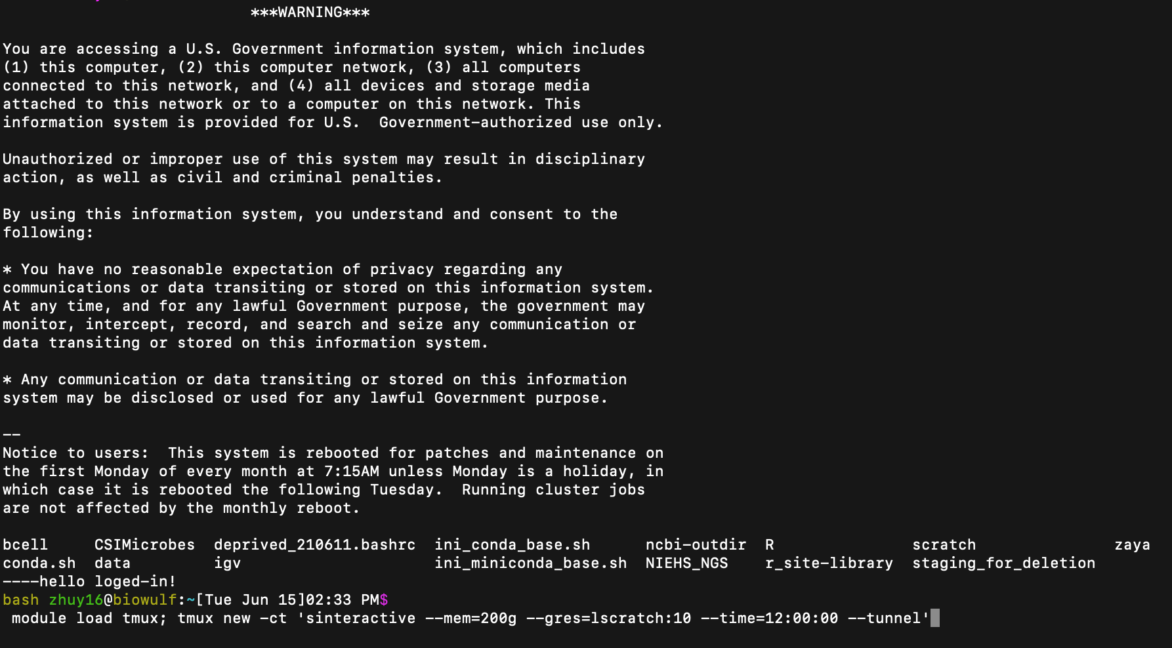
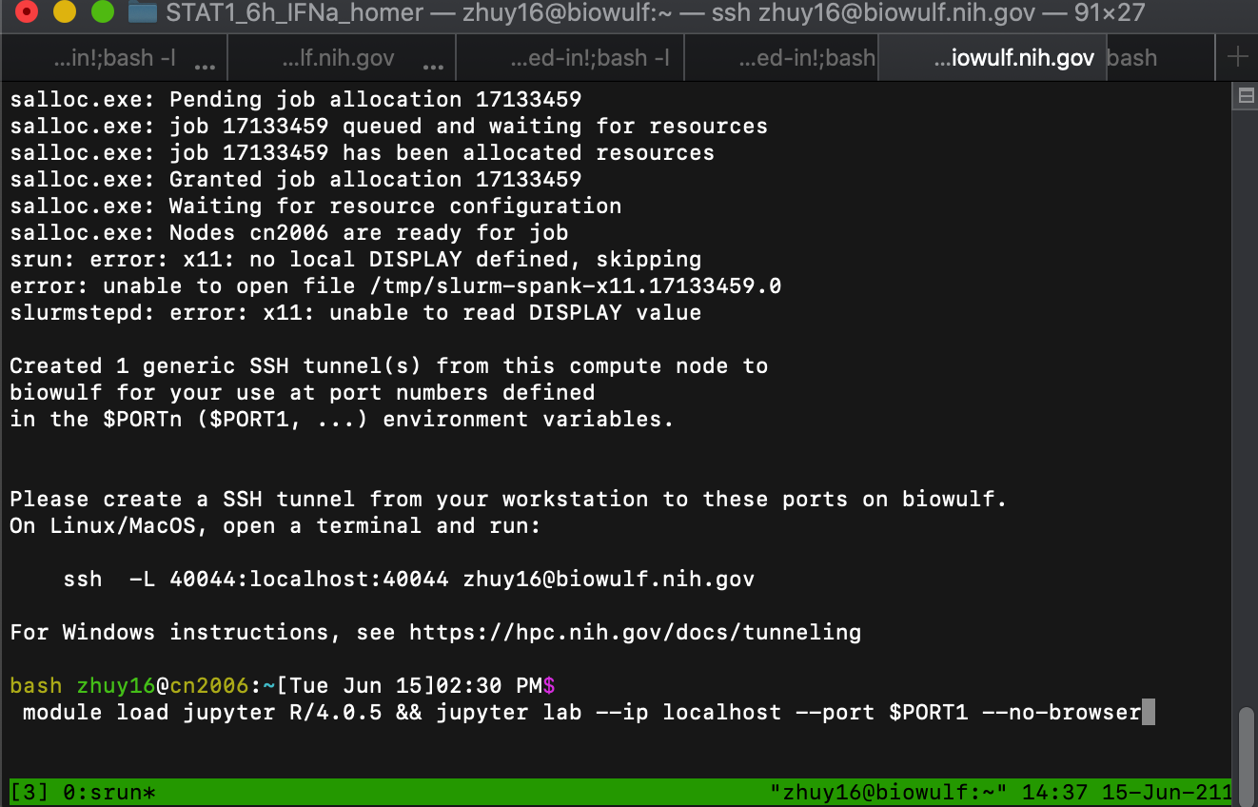
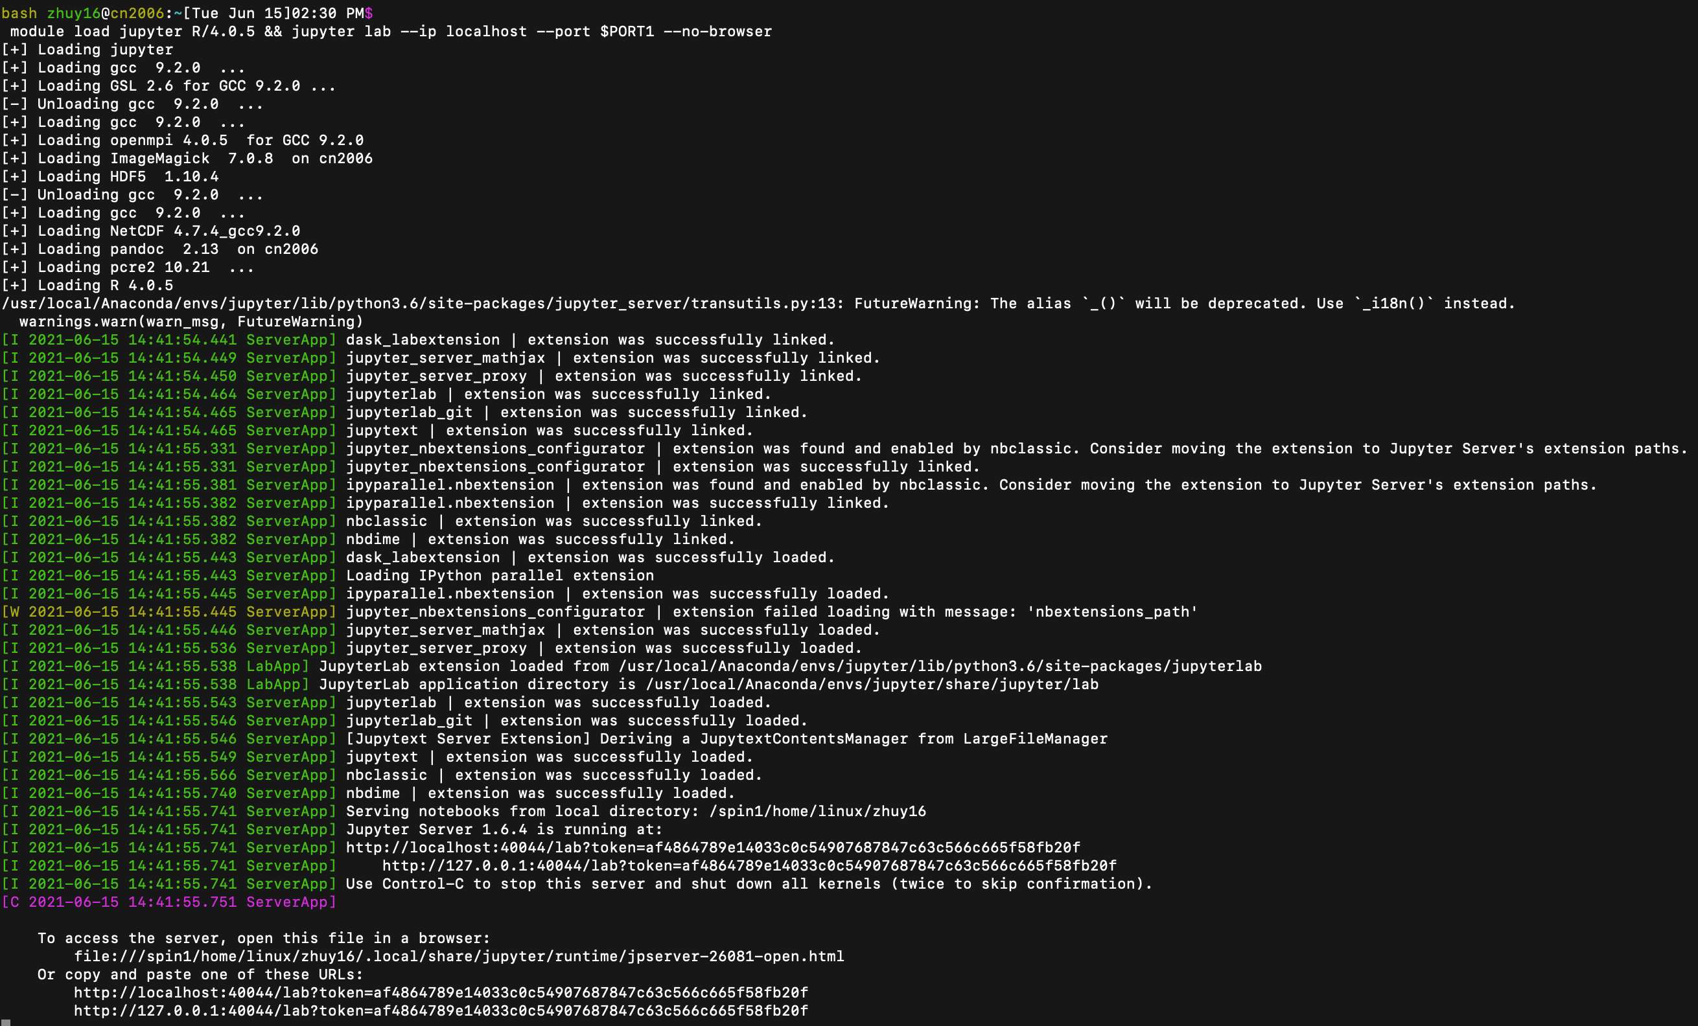
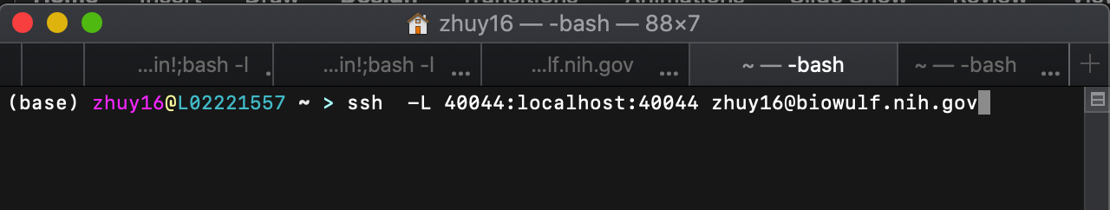
Start up the jupyter lab, --our working interface
Log in screen
# Open another terminal
ssh user_id@biowulf.nih.gov
Enter password
module load tmux
module load tmux; tmux new -ct 'sinteractive --mem=100g --time=12:00:00 --tunnel’
# Copy the tunnel script to another (3rd) terminal, execute and enter password, to establish a ssh tunnel between local computer and the work node.
module load jupyter R/4.0.5 && jupyter lab --ip localhost --port $PORT1 --no-browser
# wait until an URL link appears, copy it to your web browser, to get connected to biowulf through a jupyter lab interface.
URL
TUNNEL

Slide 5
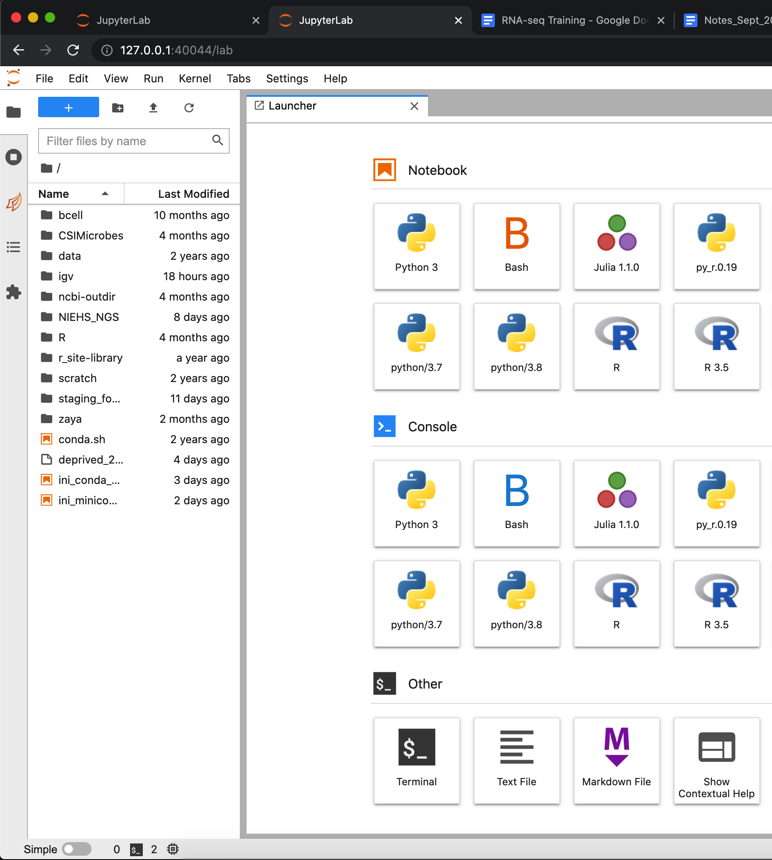
Jupyter lab
Navigate files
Bash terminal
Control kernels
Jupyter notebooks for
Kernals
Bash
R
Python
Julia
Document analysis
Git version control
Report results

Slide 6
Part II, Bulk RNA-seq

Slide 7
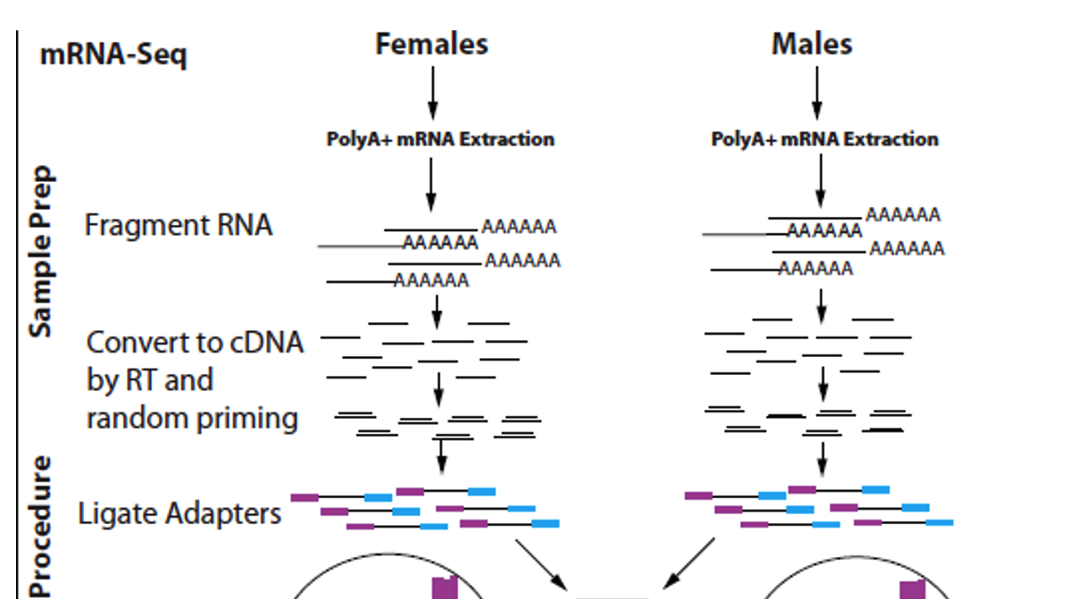
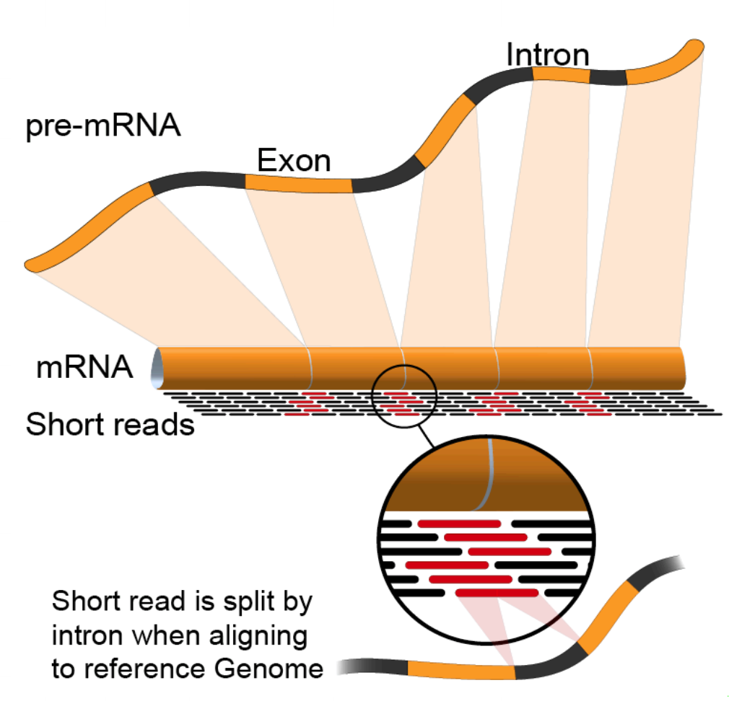
control
treatment
Part II, RNA-seq analysis
Oligo dT
Sequencing &
preprocessing
Transcriptomic
reference

Slide 8
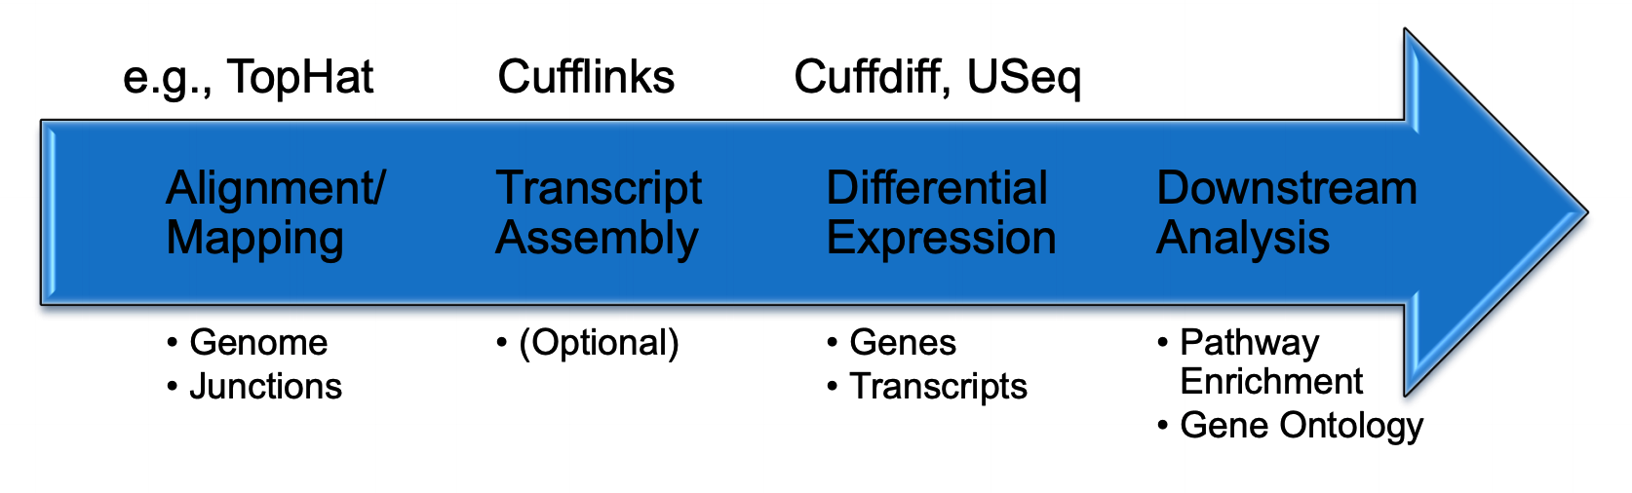
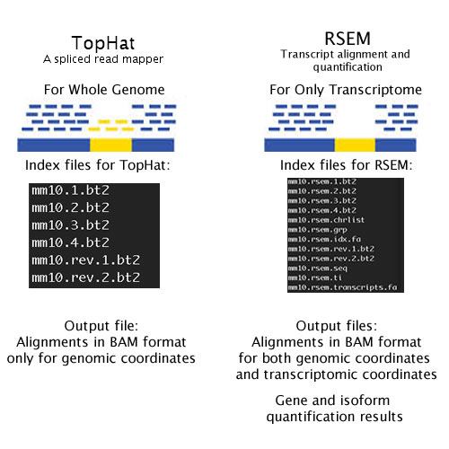
Steps
Quality filtering
Cut adaptors
Alignment
Differential expression
RSEM
DEseq2
Webgestalt,
clusterProfiler
https://bioinfo.umassmed.edu/index.php?p=33

Slide 9
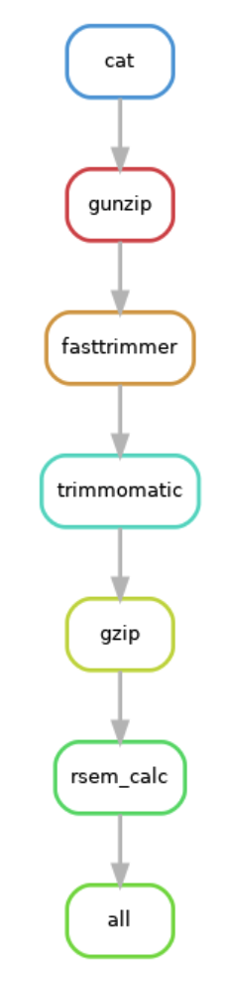
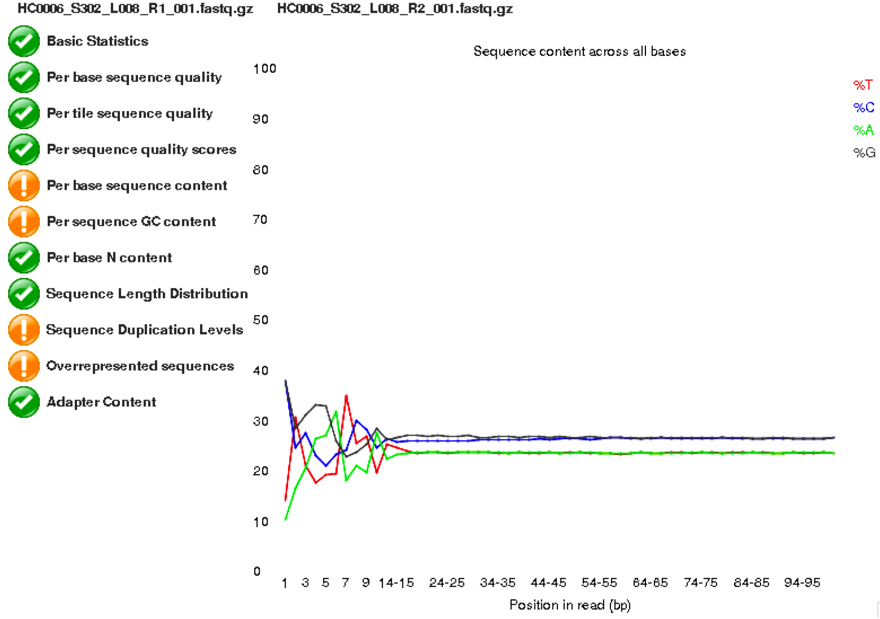
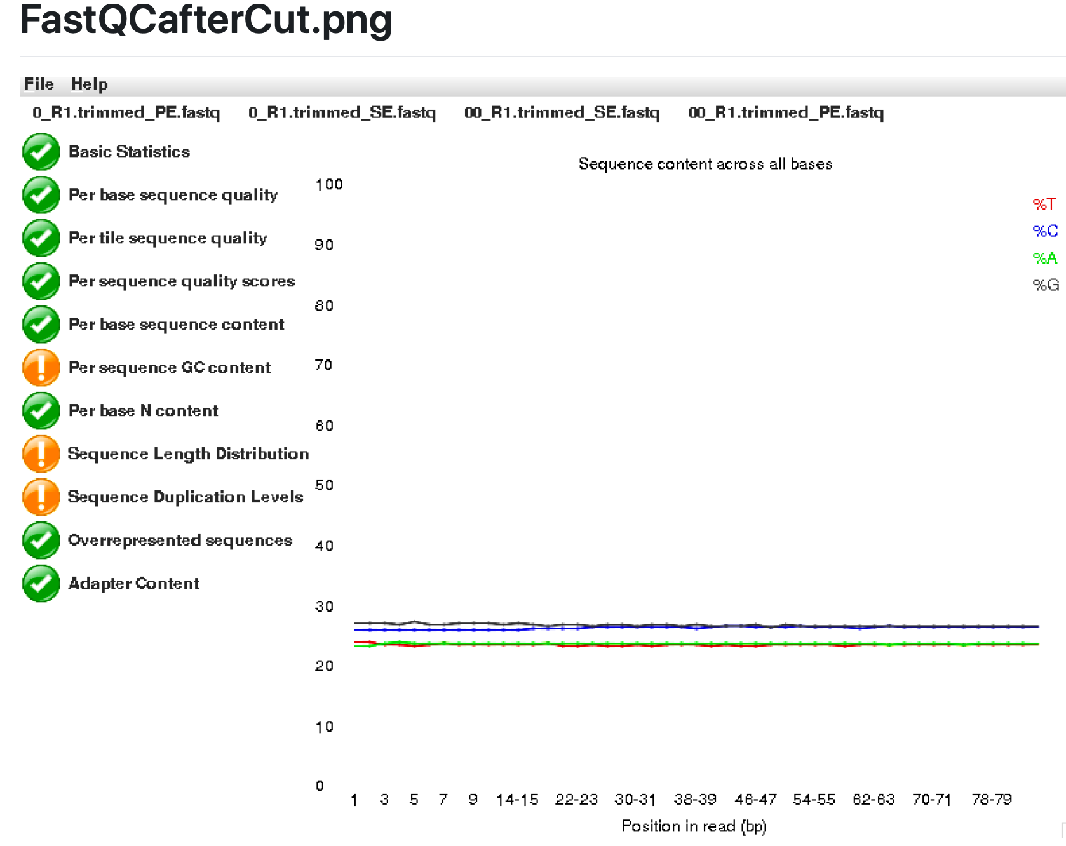
snakemake Pipeline for alignment
995Gbytes
2016 files
snakemake
pipeline
Pool fastq from different lanes.
Filtered reads and Trimmed reads
fasttrimmer
Trimmomatics
Alignment using RSEM using a UCSC gene annotation reference
Pooling counts
Formatting metadata
Differential expression DESeq2
Functional annotation
GSEA
Enrichment analysis
Cellular decomposition
Cell type deconvolution
Snakemake
pipeline
Jupyter
Notebooks
on Biowulf
Alignment to
UCSC reference transcriptome
by RSEM
Collection of counts to form a count matrix
And alignment statistics
145 files
*.genes.results

Slide 10
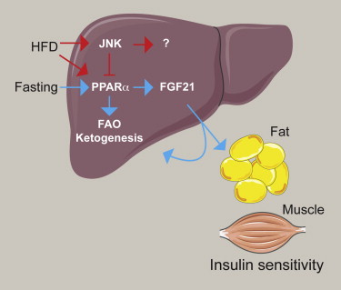
Demo on RNA-seq: a small sample data
Paired-end sequencing
6 samples
3 wild type
3 JNK1/2 double knockout
https://www.sciencedirect.com/science/article/pii/S1550413114002757?via%3Dihub

Slide 11
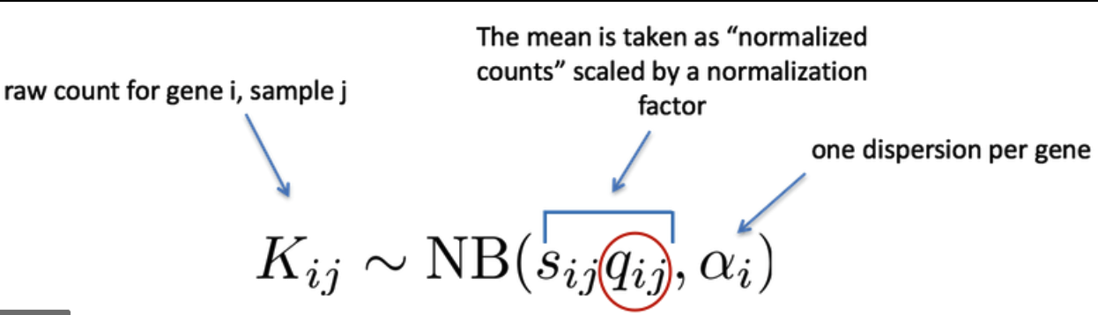
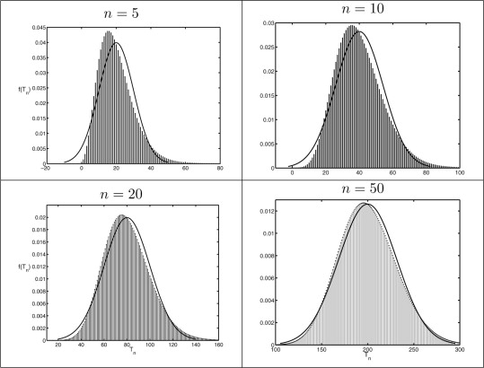
DESeq2 models raw count with negative binomial distribution, not with normal/gaussian distribution
Dispersion vs sd
Wald test vs t test
Correction of p values for multiple testing,
FDR/Benjamini-Hochberg → Bonferroni
(loose → stringent)
https://hbctraining.github.io/DGE_workshop_salmon/lessons/05_DGE_DESeq2_analysis2.html

Slide 12
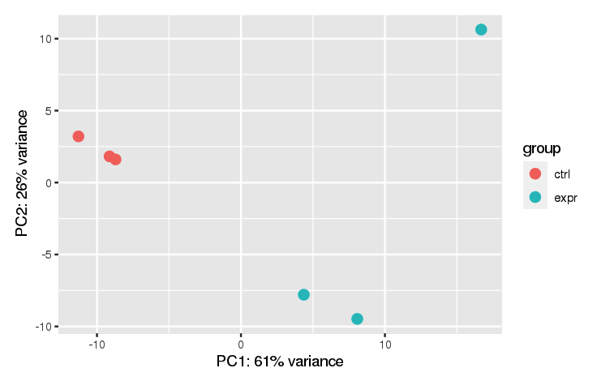
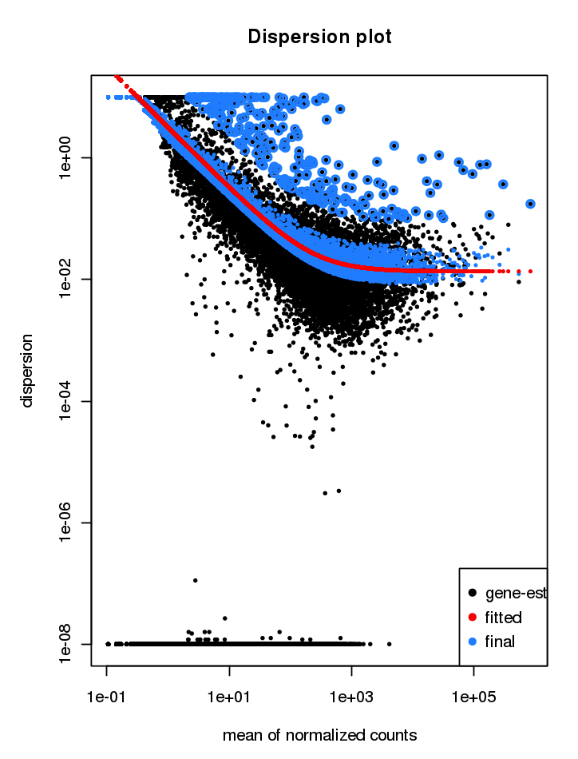
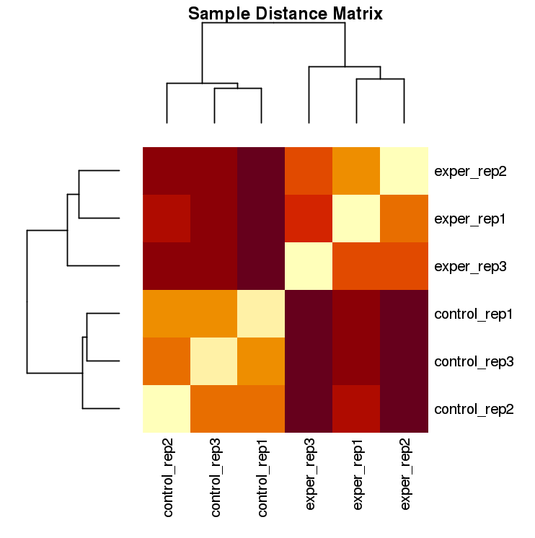
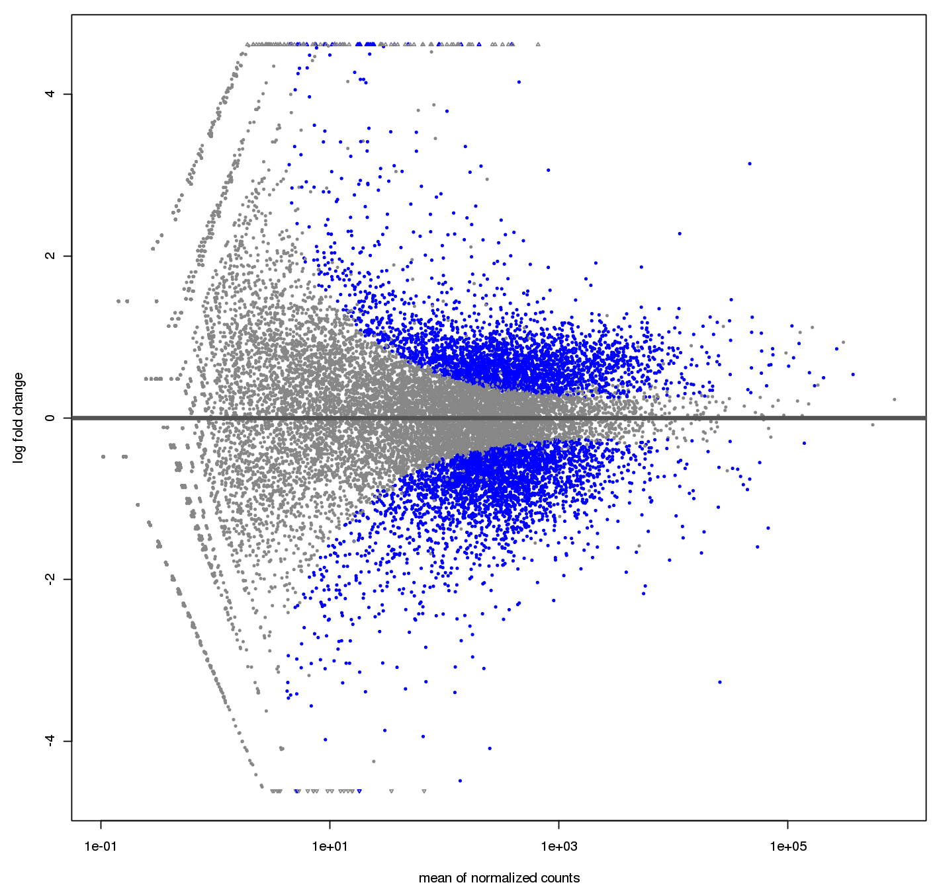
Plots
PCA plot
Dispersion plot
Correlation heatmap
MA plot

Slide 13
Visualizing pathway—gene relationship Example: selected GO-BP
Redundancy of pathway names

Slide 14
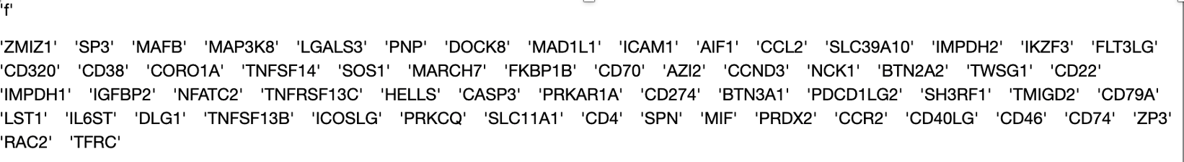
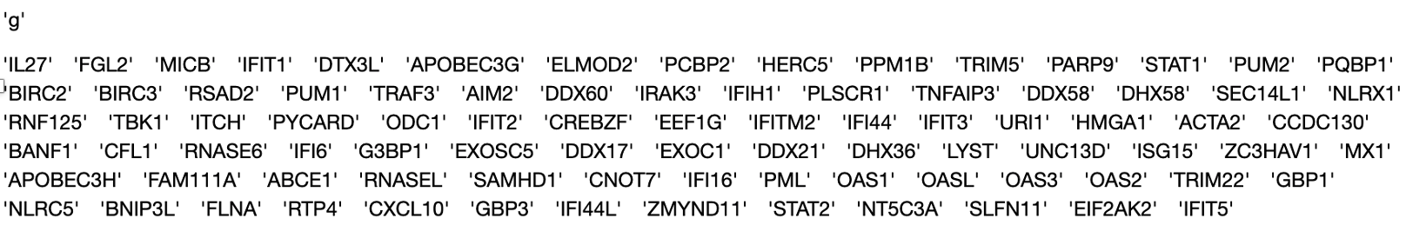
Gene-Pathway incidence heatmap
Package:
multienrichjam
T cell activation, genes
Response to virus, genes
Interferon response is a distinguishing pathway, and here are the genes

Slide 15
Reference
Bulk RNA-seq
The pipeline and dataset 1
https://github.com/UMMS-Biocore/RNASeqTutorial/blob/master/RNASeqTutorial.pdf
Dataset 2
https://bioinfo.umassmed.edu/index.php?p=35#p1e3
Functional annotation of gene lists.
Webgestalt, http://www.webgestalt.org/2017/option.php
clusterProfiler
Overrepresentation Enrichment analysis (OEA)
Geneset Enrichment Analysis (GSEA)
Ingenuity Pathway Analysis (IPA)
multienrichjam, https://jmw86069.github.io/multienrichjam/articles/importIPA.html
Network analysis
Cytoscape and apps https://cytoscape.org/

Slide 16
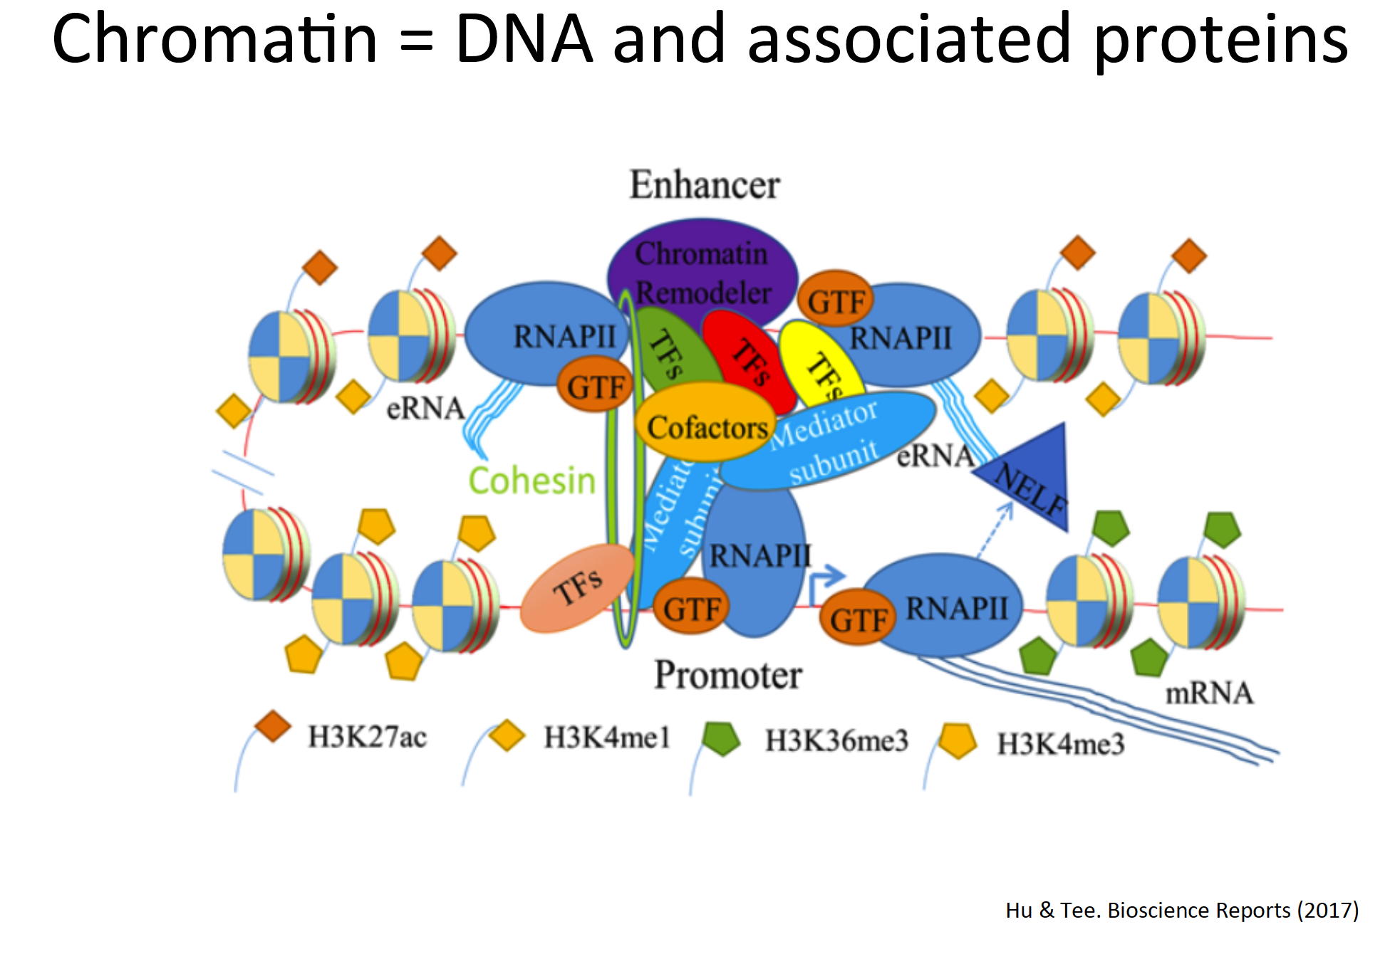
Part III, Chromatin Immuno Precipitation Sequencing (ChIP-seq)
Background and related chromatin types
Peaks and input Controls
Quality controls
Workflow and sample data
Demo on BioWulf

Slide 17
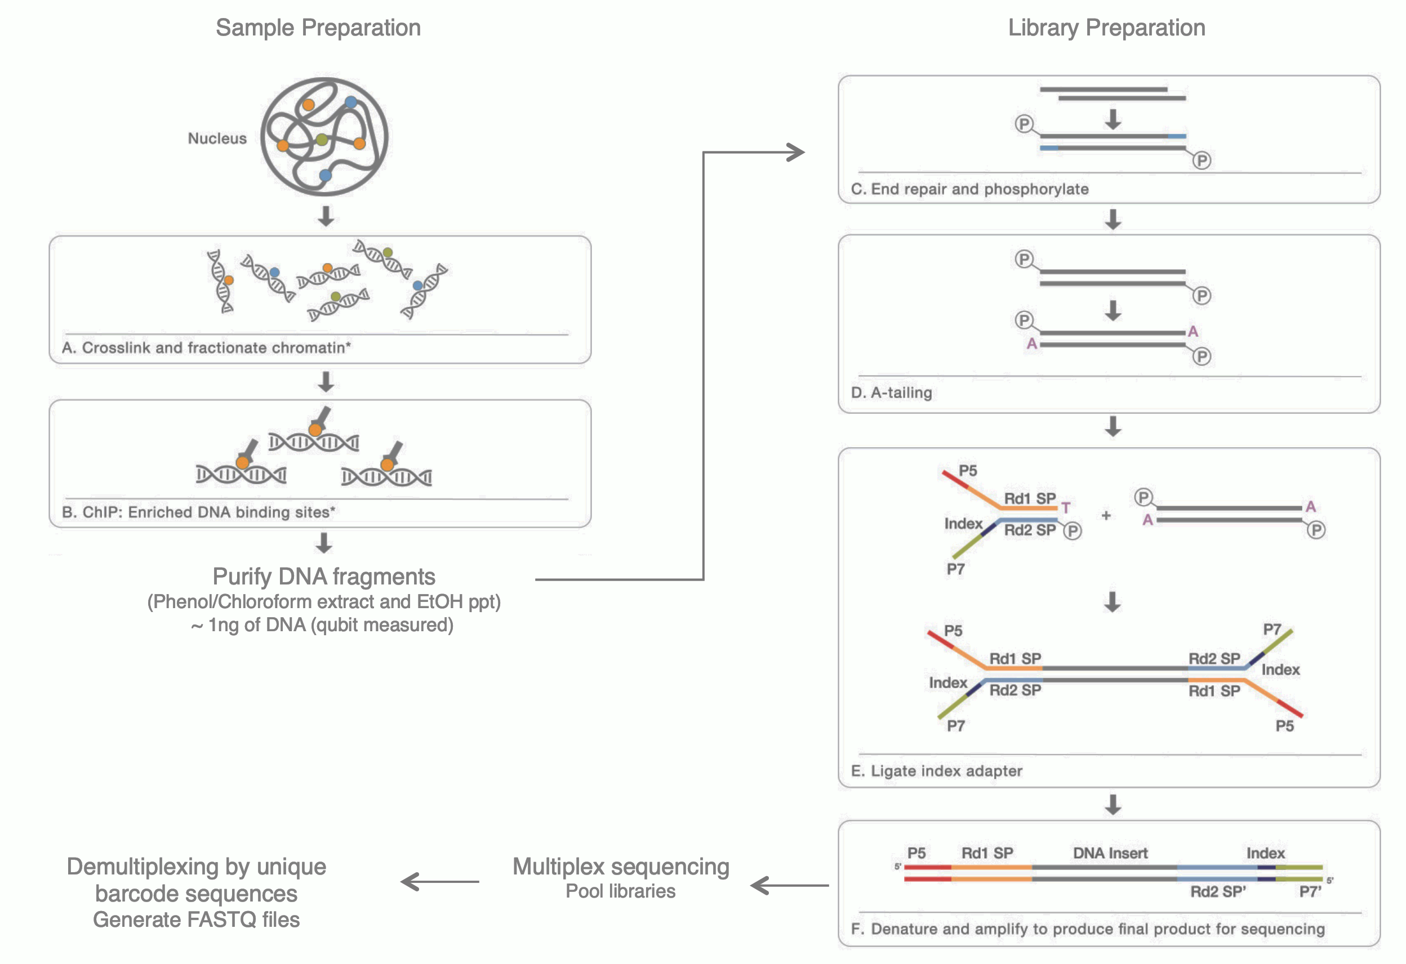
ChIP-seq

Slide 18
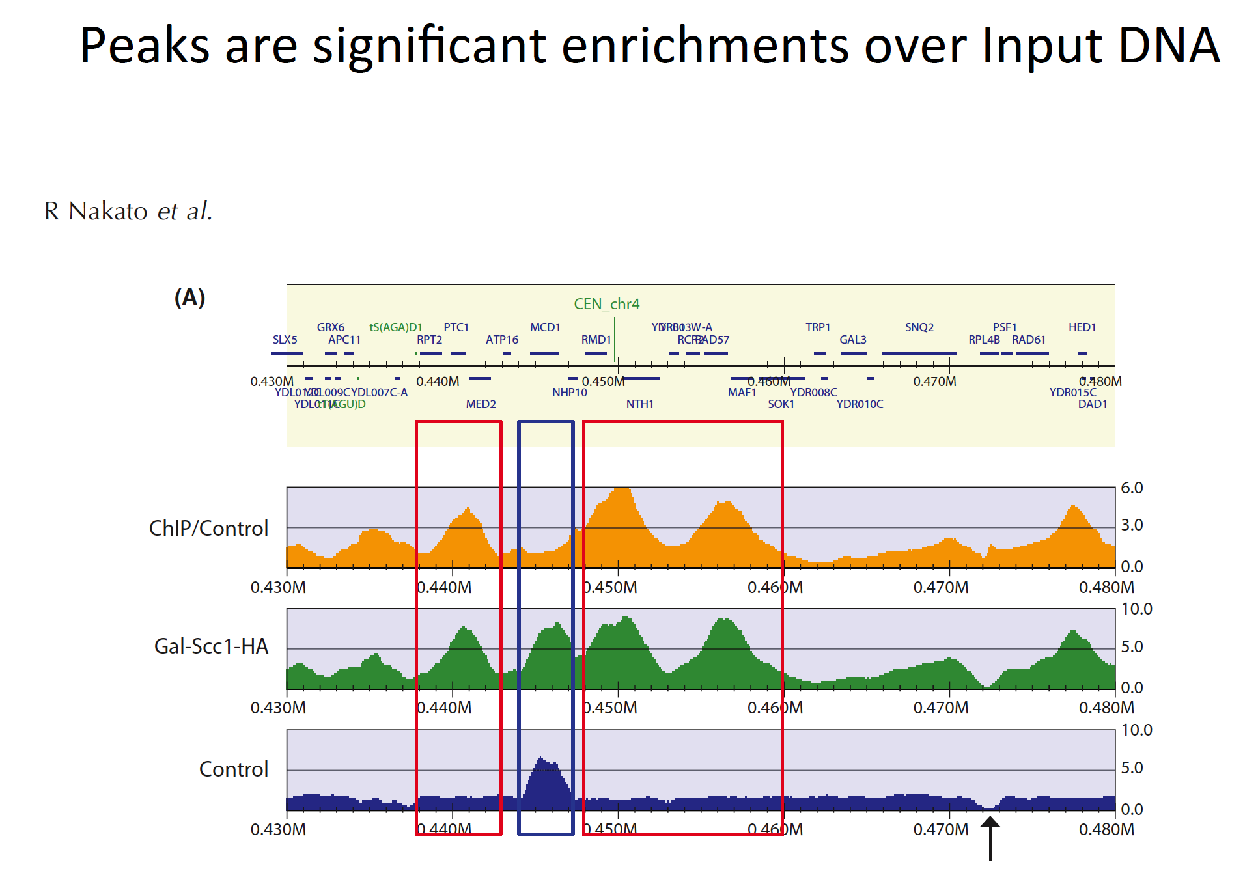
Control can be used in
MACS2 peak calling
Homer differential peaks
DiffBind greylist removal
Peaks in greylist
& known blacklist

Slide 19
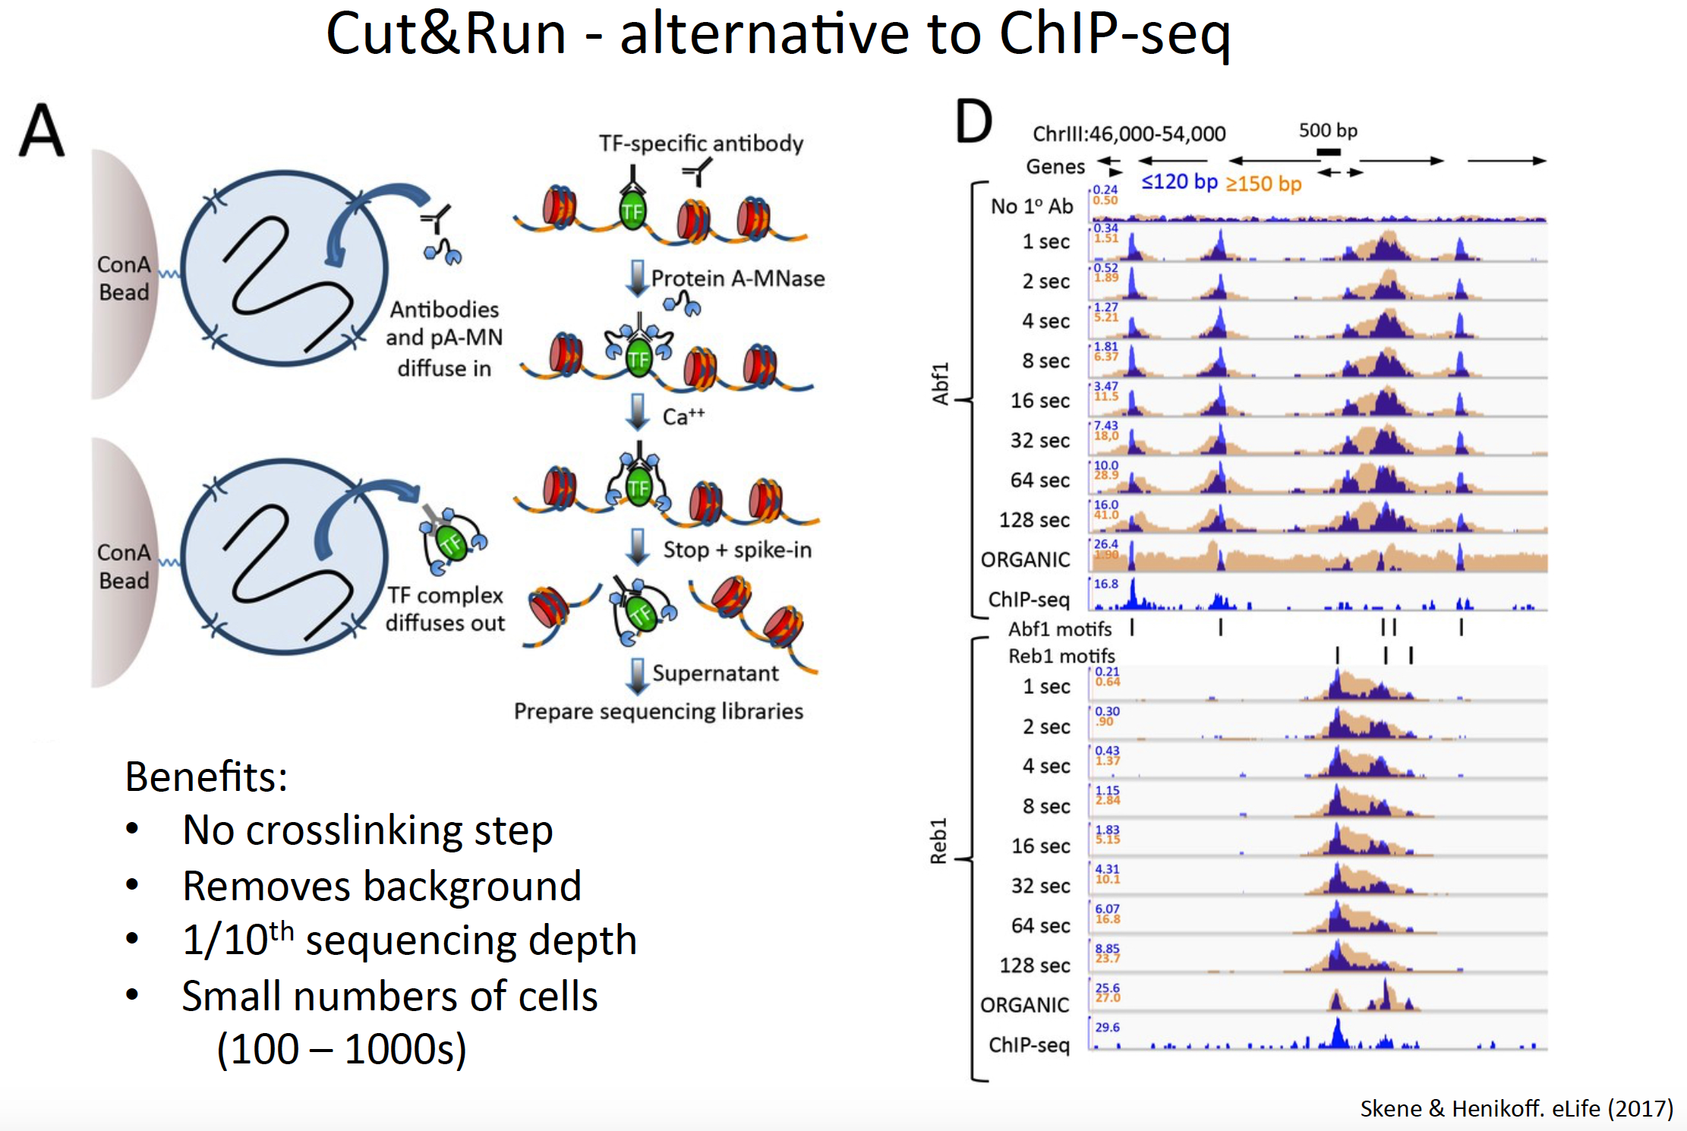

Slide 20
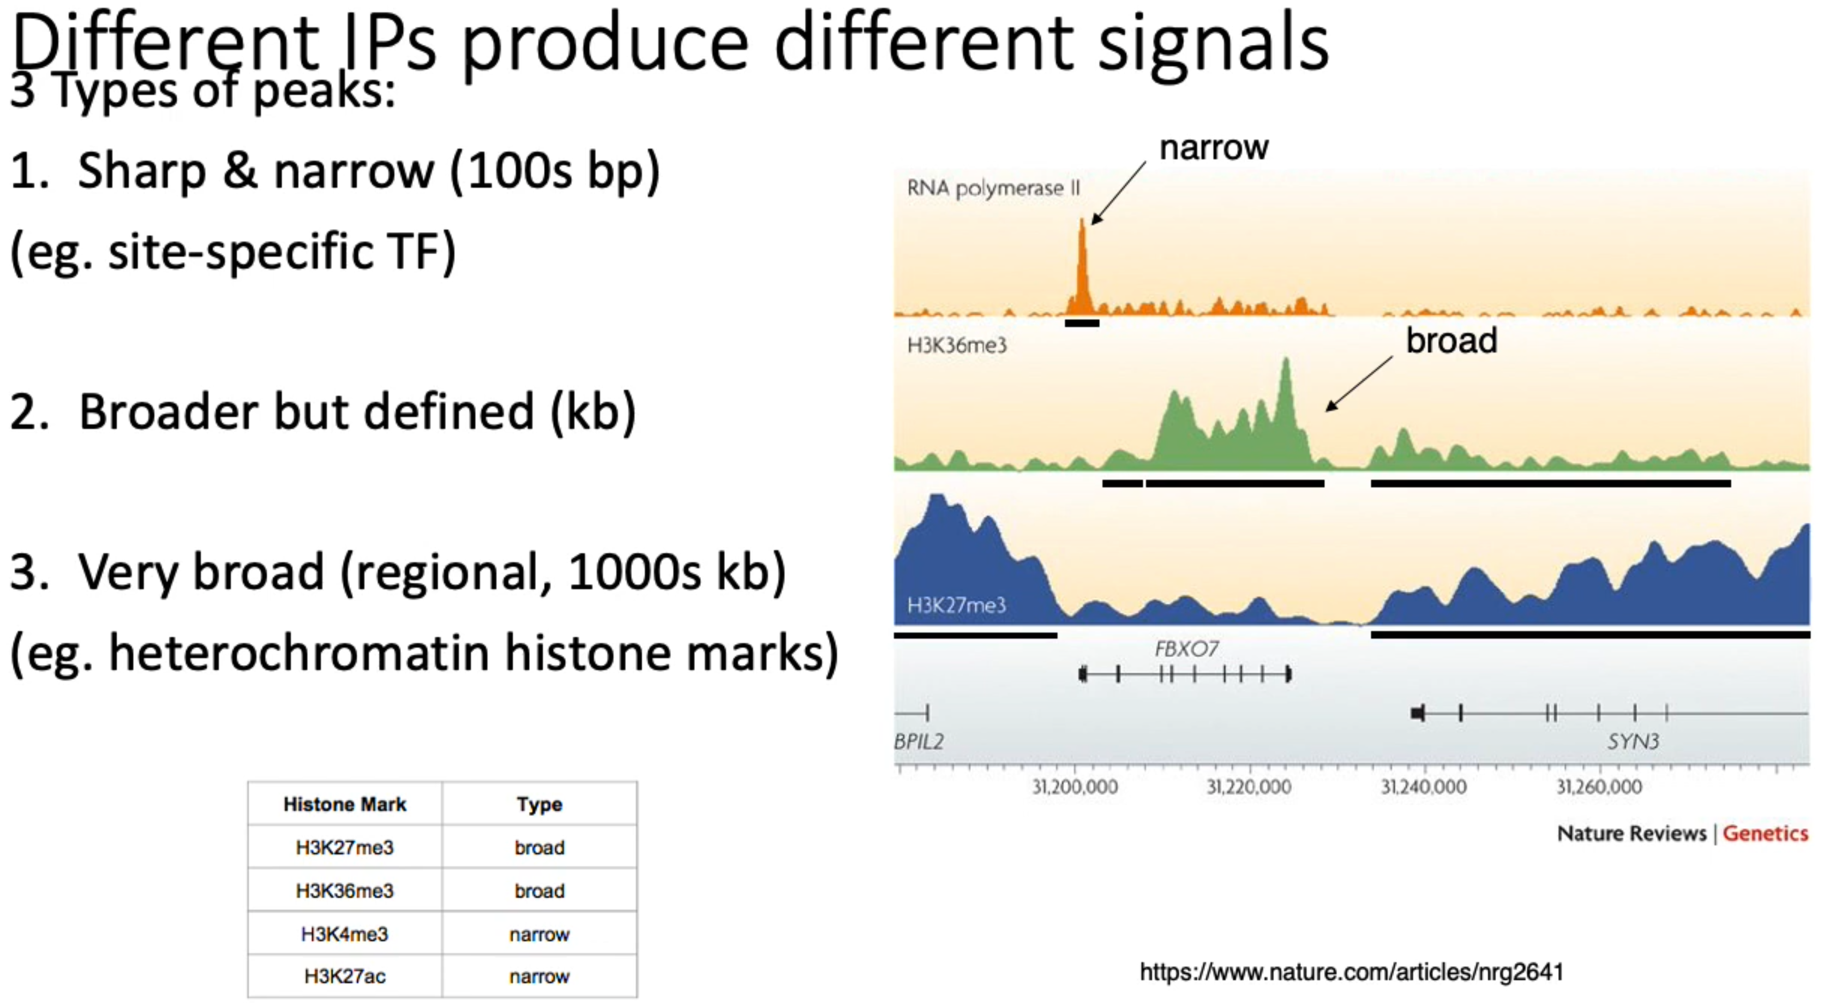
Different IP produce different type of peaks
f

Slide 21
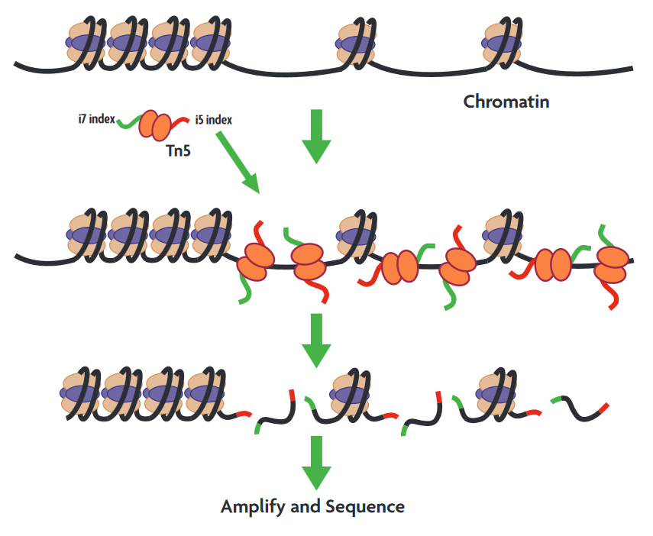
ATAC-seq is very similar but has no input control
ATAC-seq assess regions of genome that is not compacted
Processing of ATAC-seq is very similar to ChIP-seq
There is no input control for ATAC-seq.
https://www.bioscience.co.uk/cpl/atac-seq-kit

Slide 22
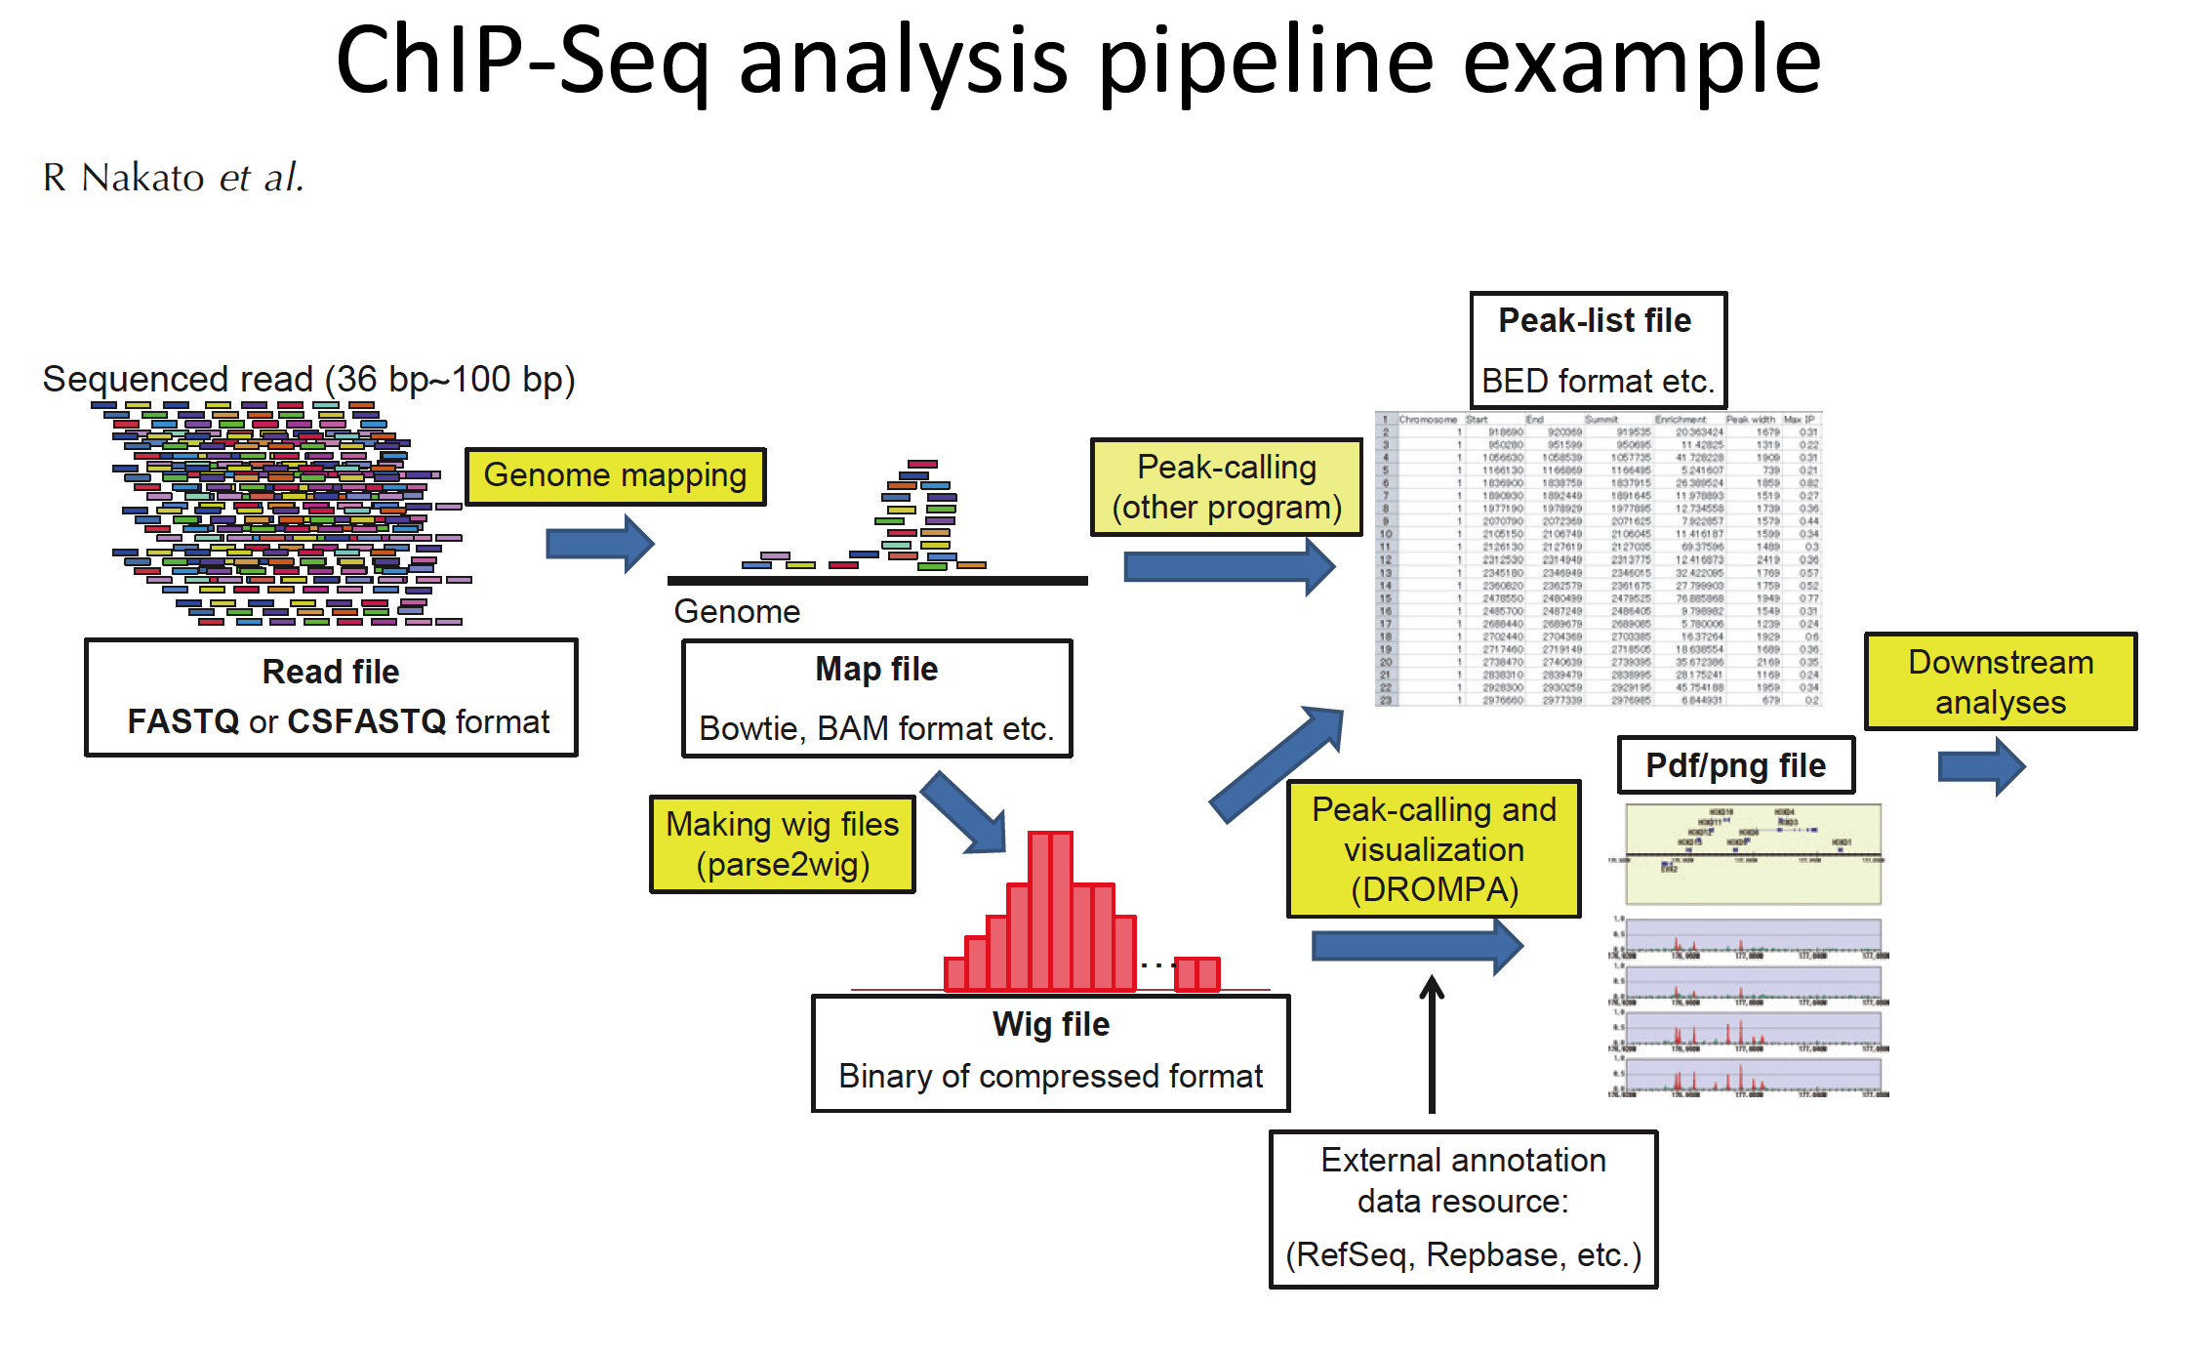
https://m.ensembl.org/info/website/upload/bed.html

Slide 23
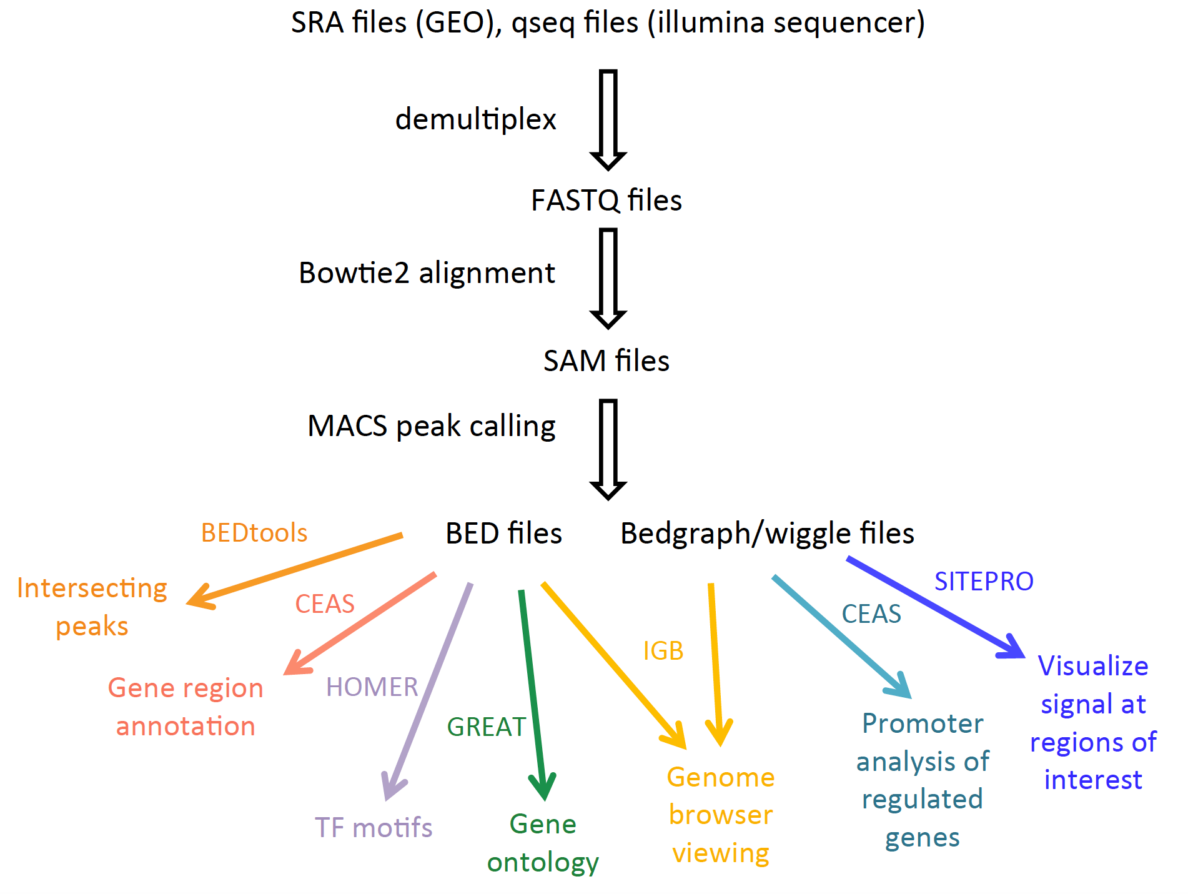
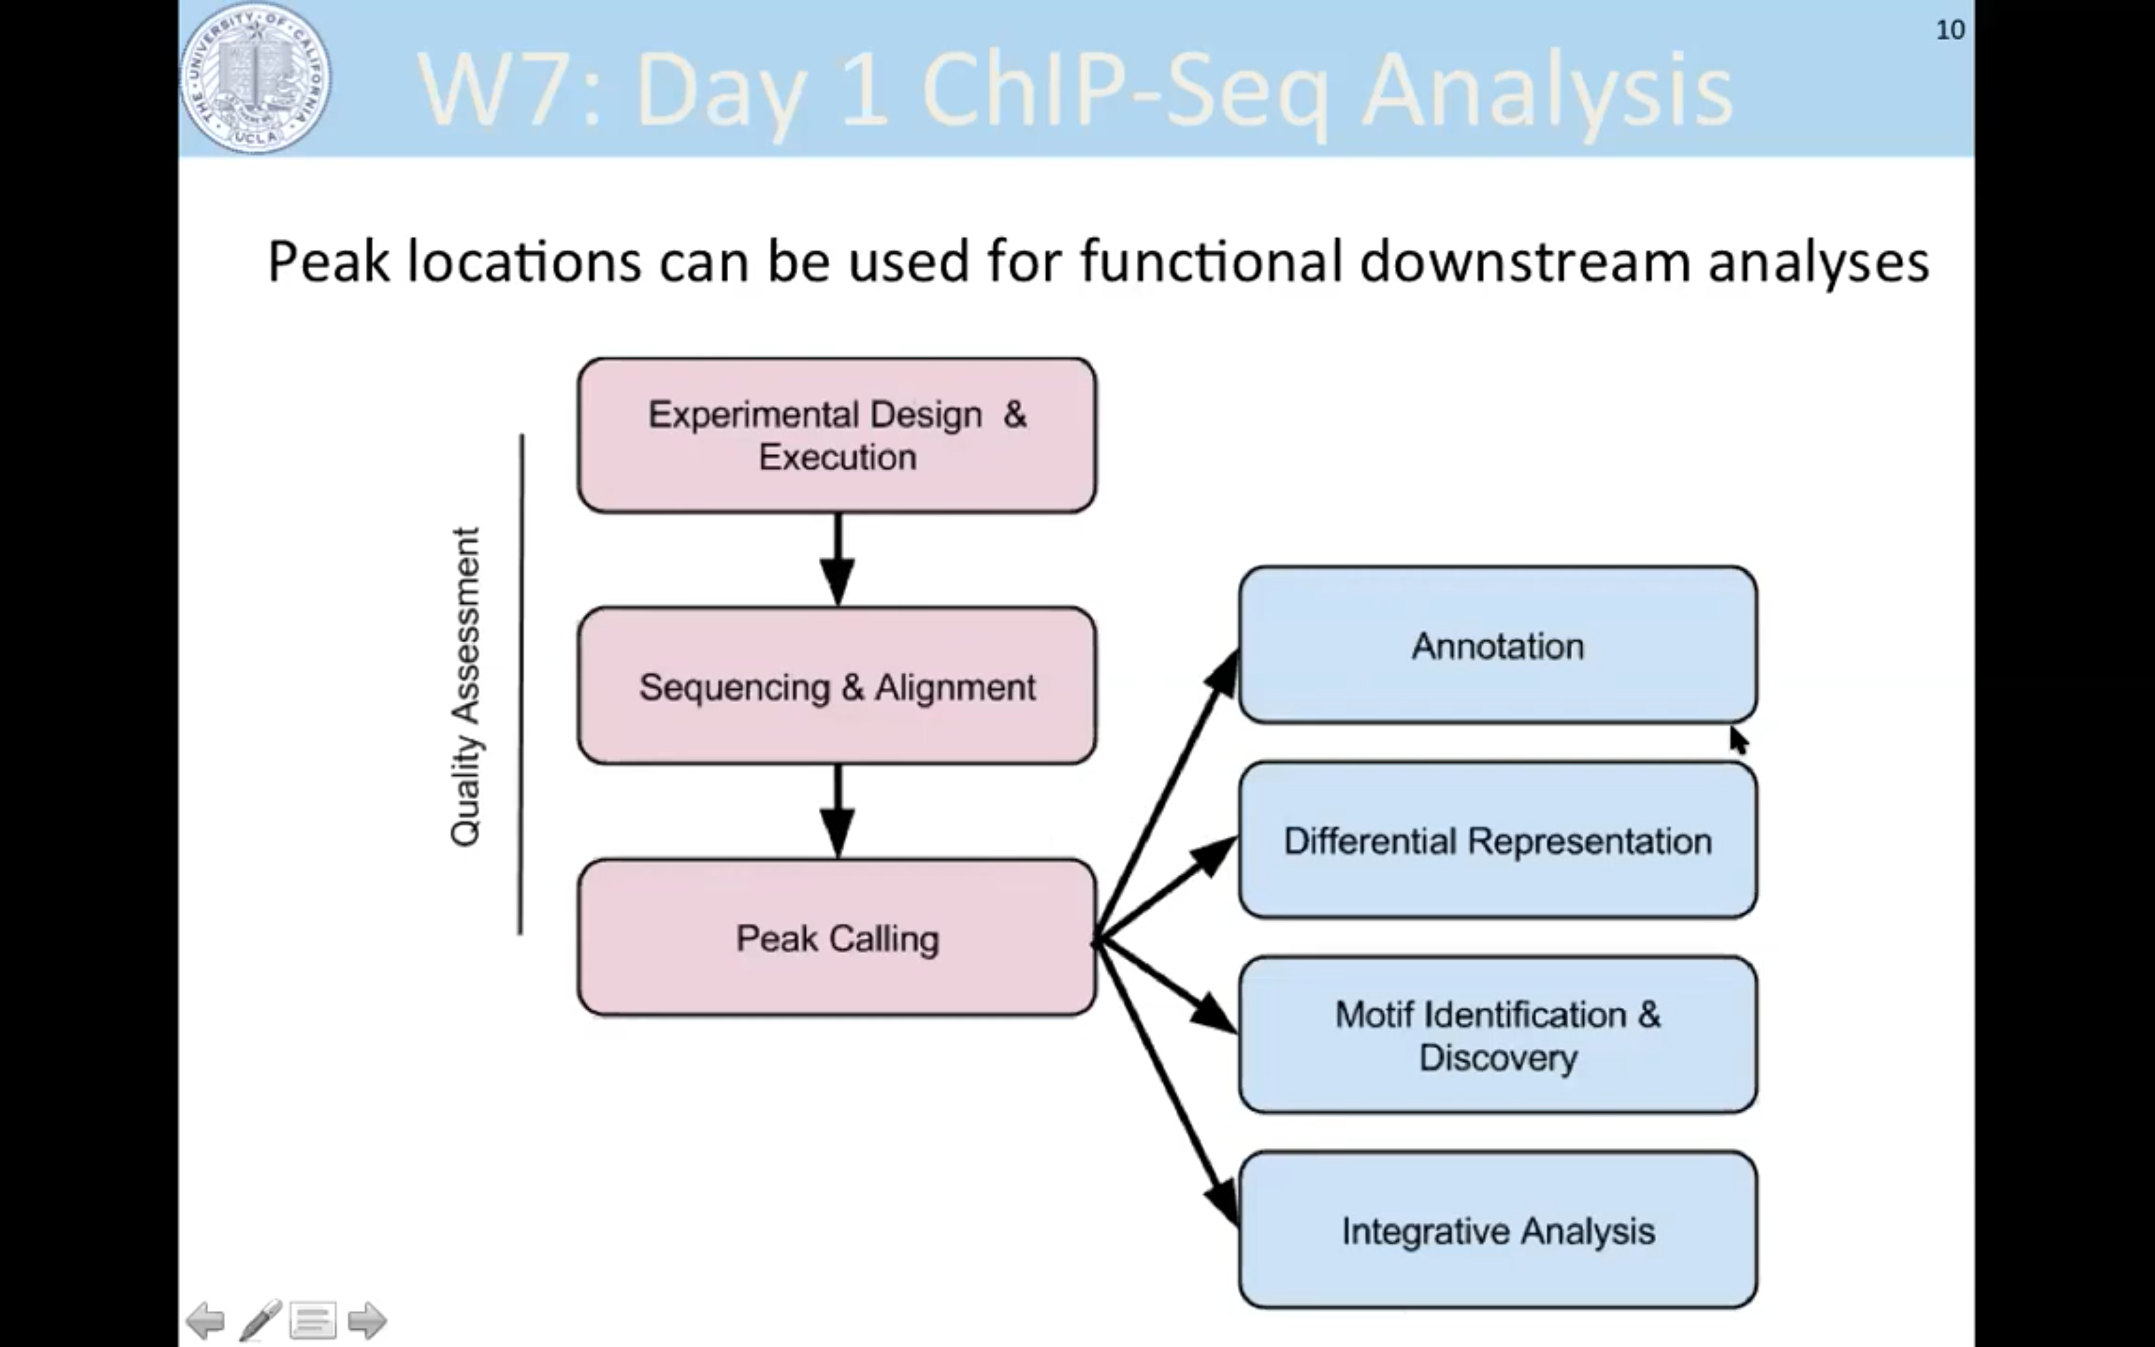
Part II, ChIP-seq analysis

Slide 24
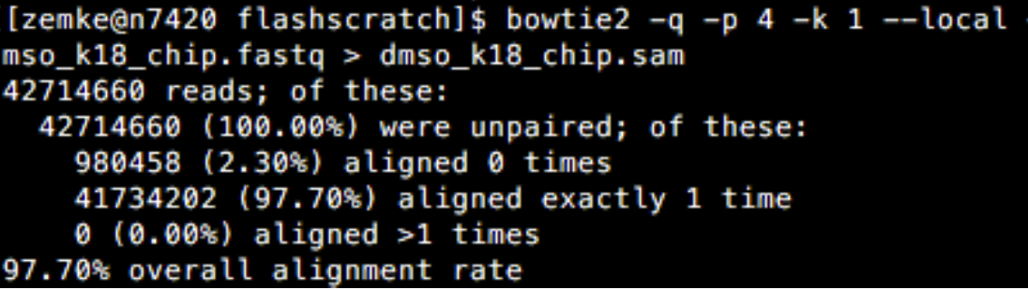
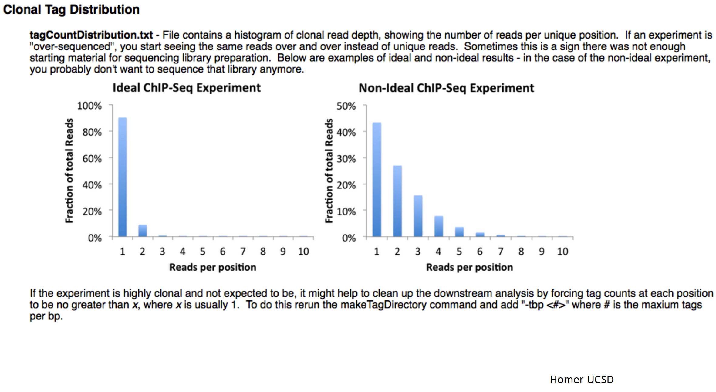
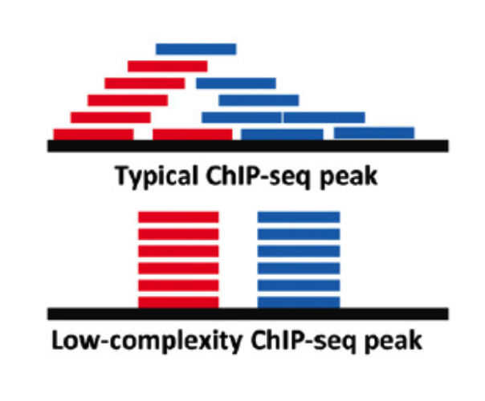
Complexity of library

Slide 25
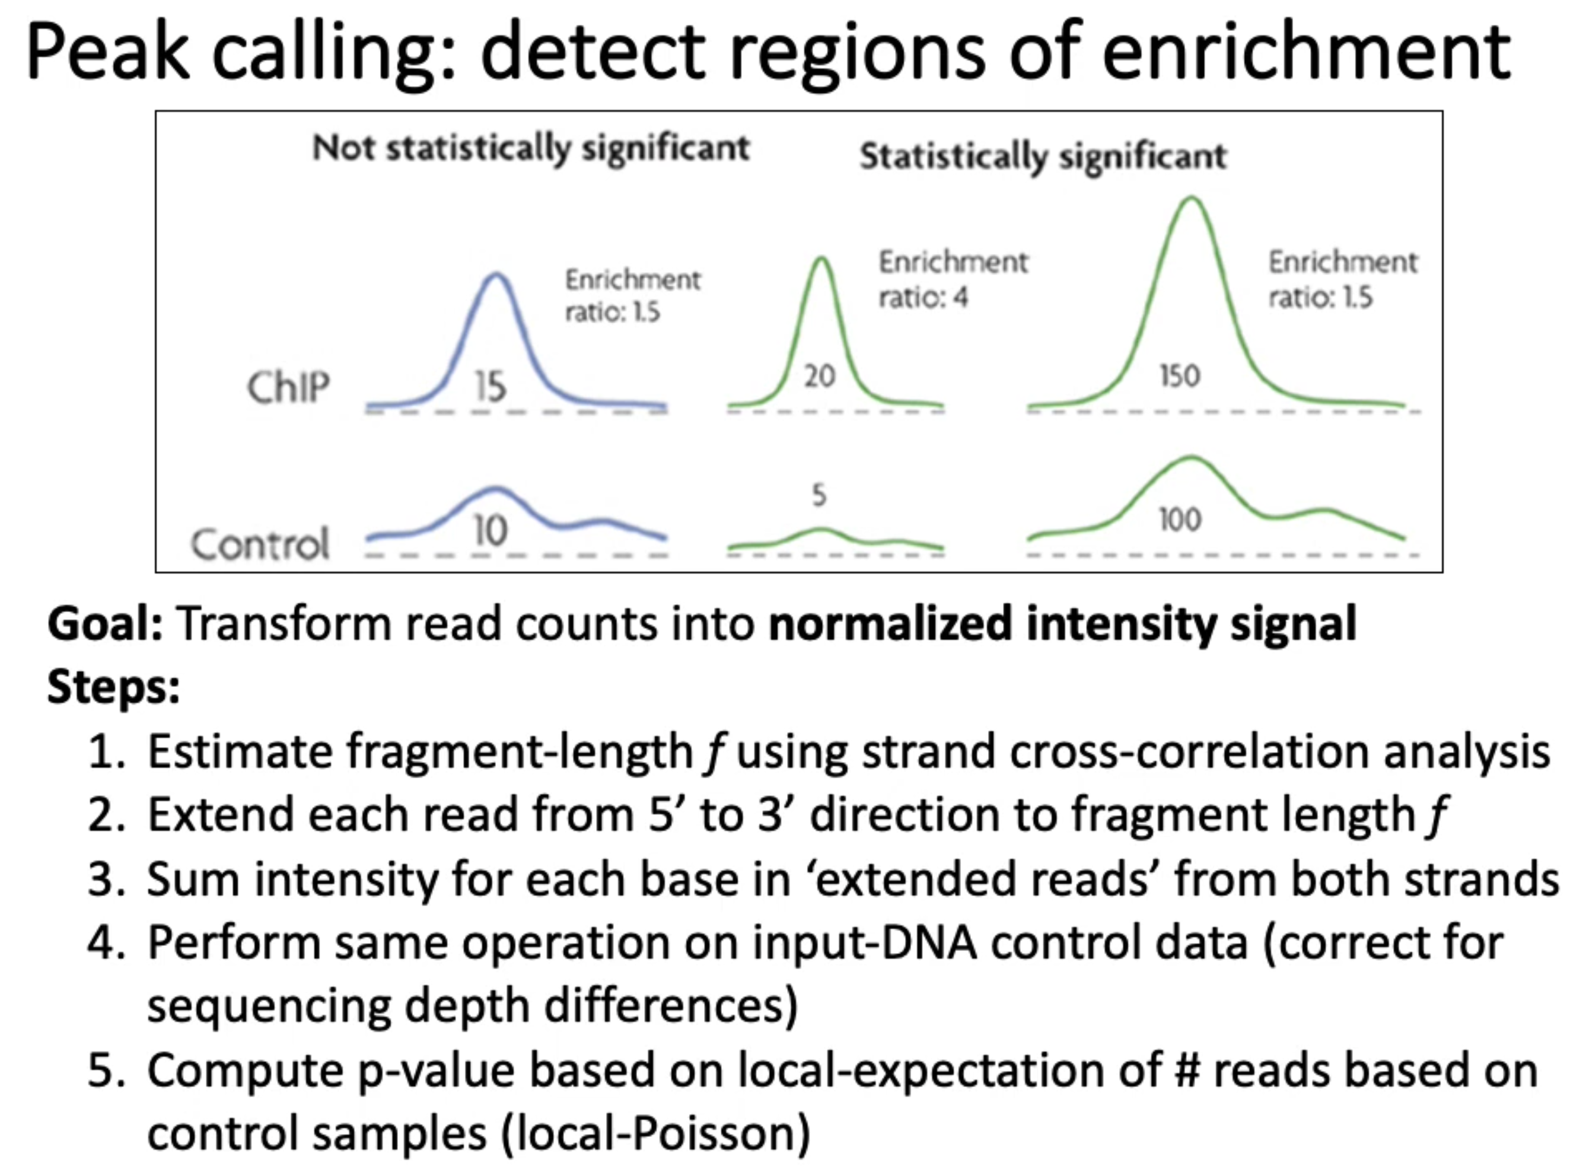
https://www.youtube.com/watch?v=XWcWn8dt4c8

Slide 26
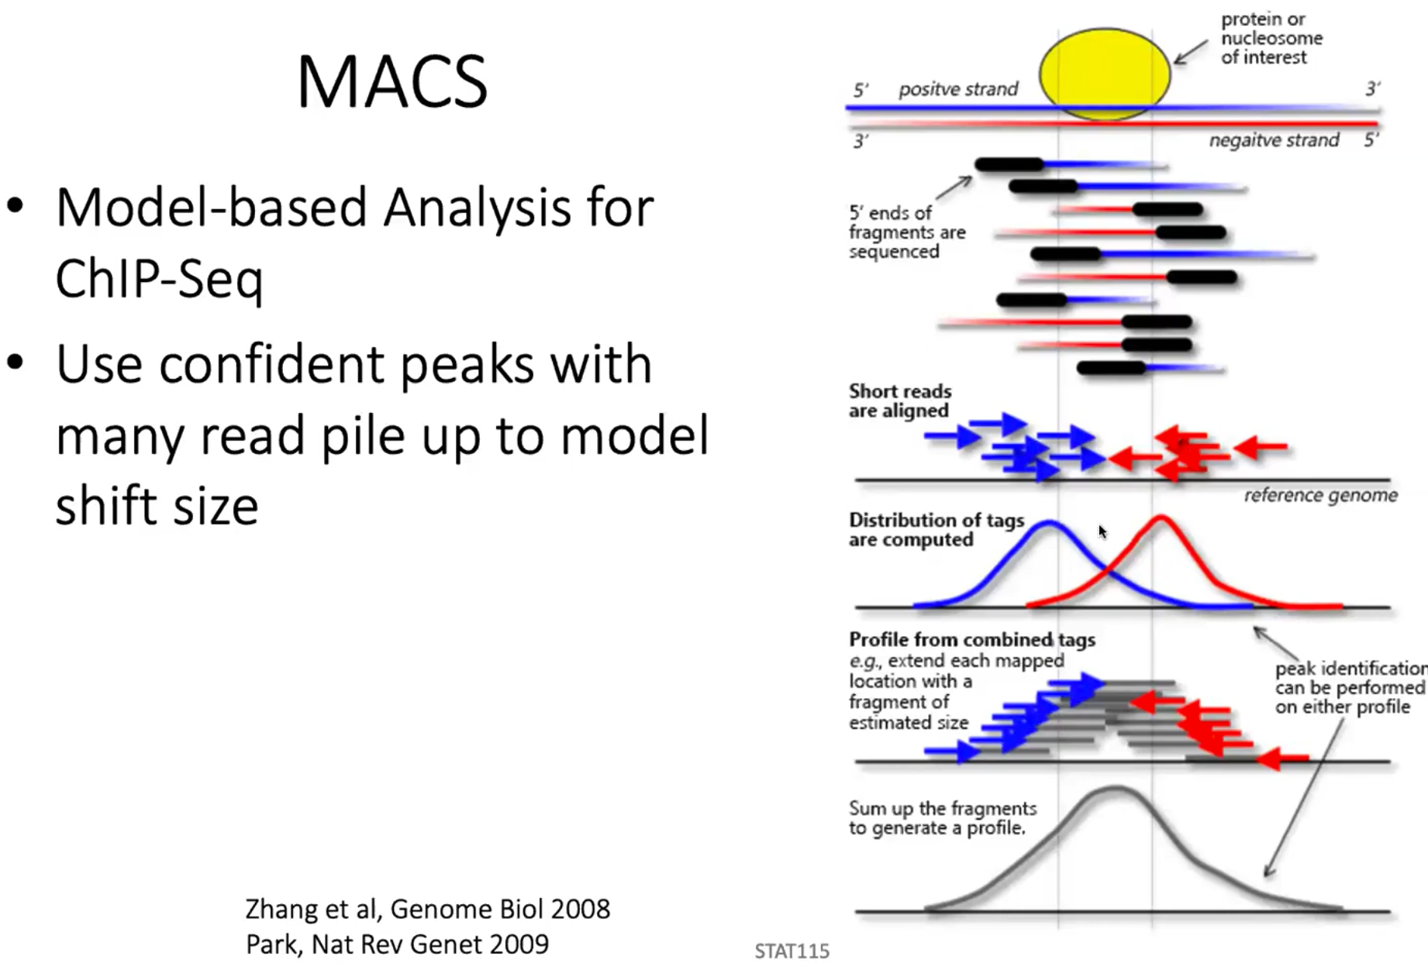
Model is for single end sequencing.
For paired end, modeling step is ignored.

Slide 27
Quality controls
If DNA is over-fragmented, the phantom peak will be high
If fragmentation is aproperiate, ChIP peak will dominate the strand shift.

Slide 28
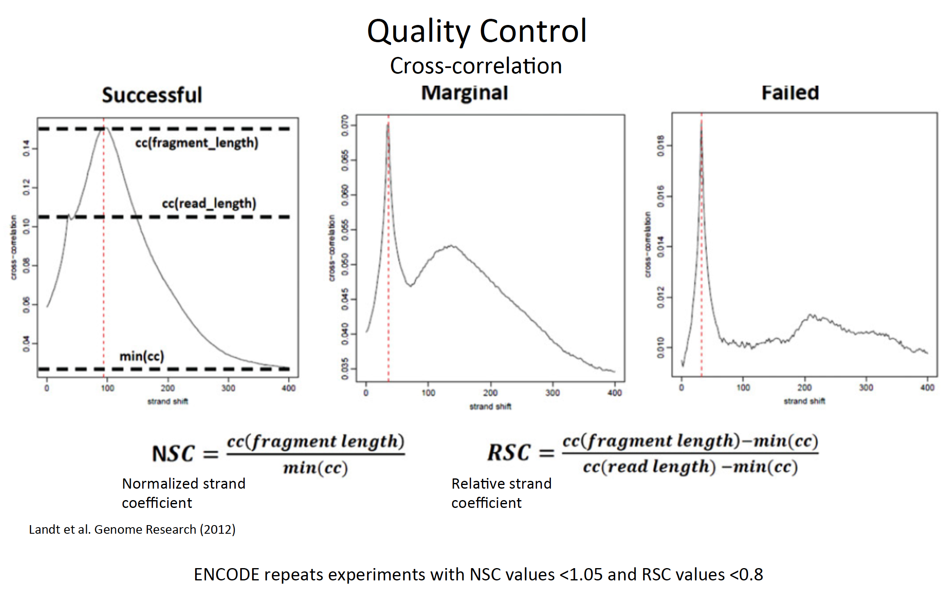

Slide 29
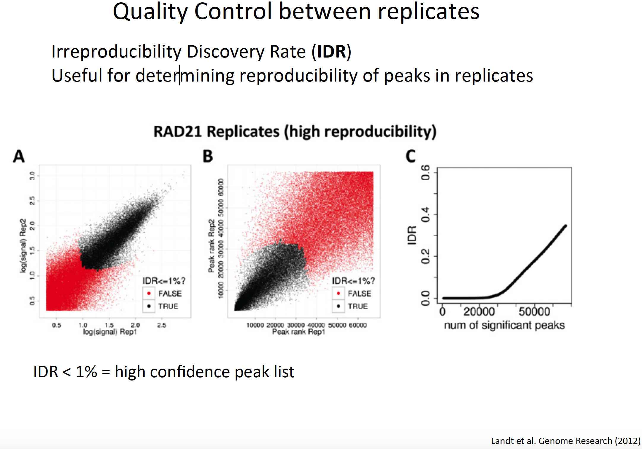
Quality control between replicates
High variability between replicates
Used correlation between ranking of peaks of each replicate
More useful for replicates of 2, difficult to implement for bigger numbers of replicates.

Slide 30
Downstream analysis
Peak (bed file) operation using bedtools
Visualization of peaks using IGM
Annotate peaks with adjacent genes using CEAS
Annotate peak locations relative to promoter and Gene ontology using GREAT
Find enriched motifs from peaks using Homer

Slide 31
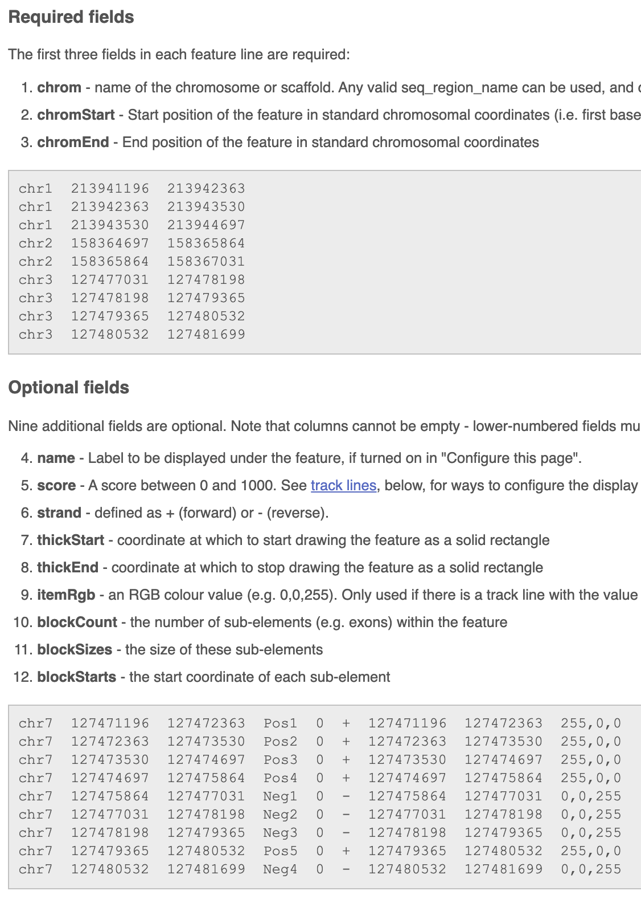
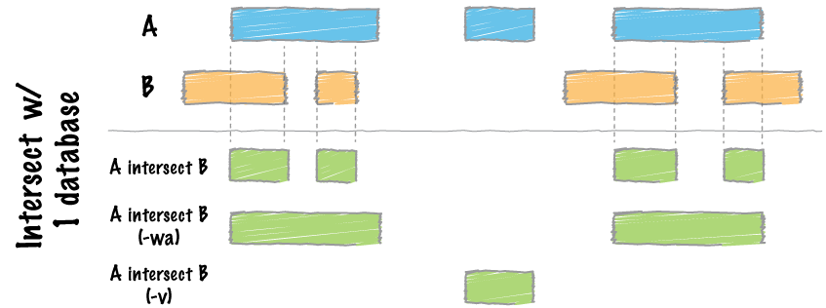
Bed file operations
Bed file format
Bedtools intersect -wa s1.bed s2.bed
Bedtools intersect -v s1.bed s2.bed

Slide 32
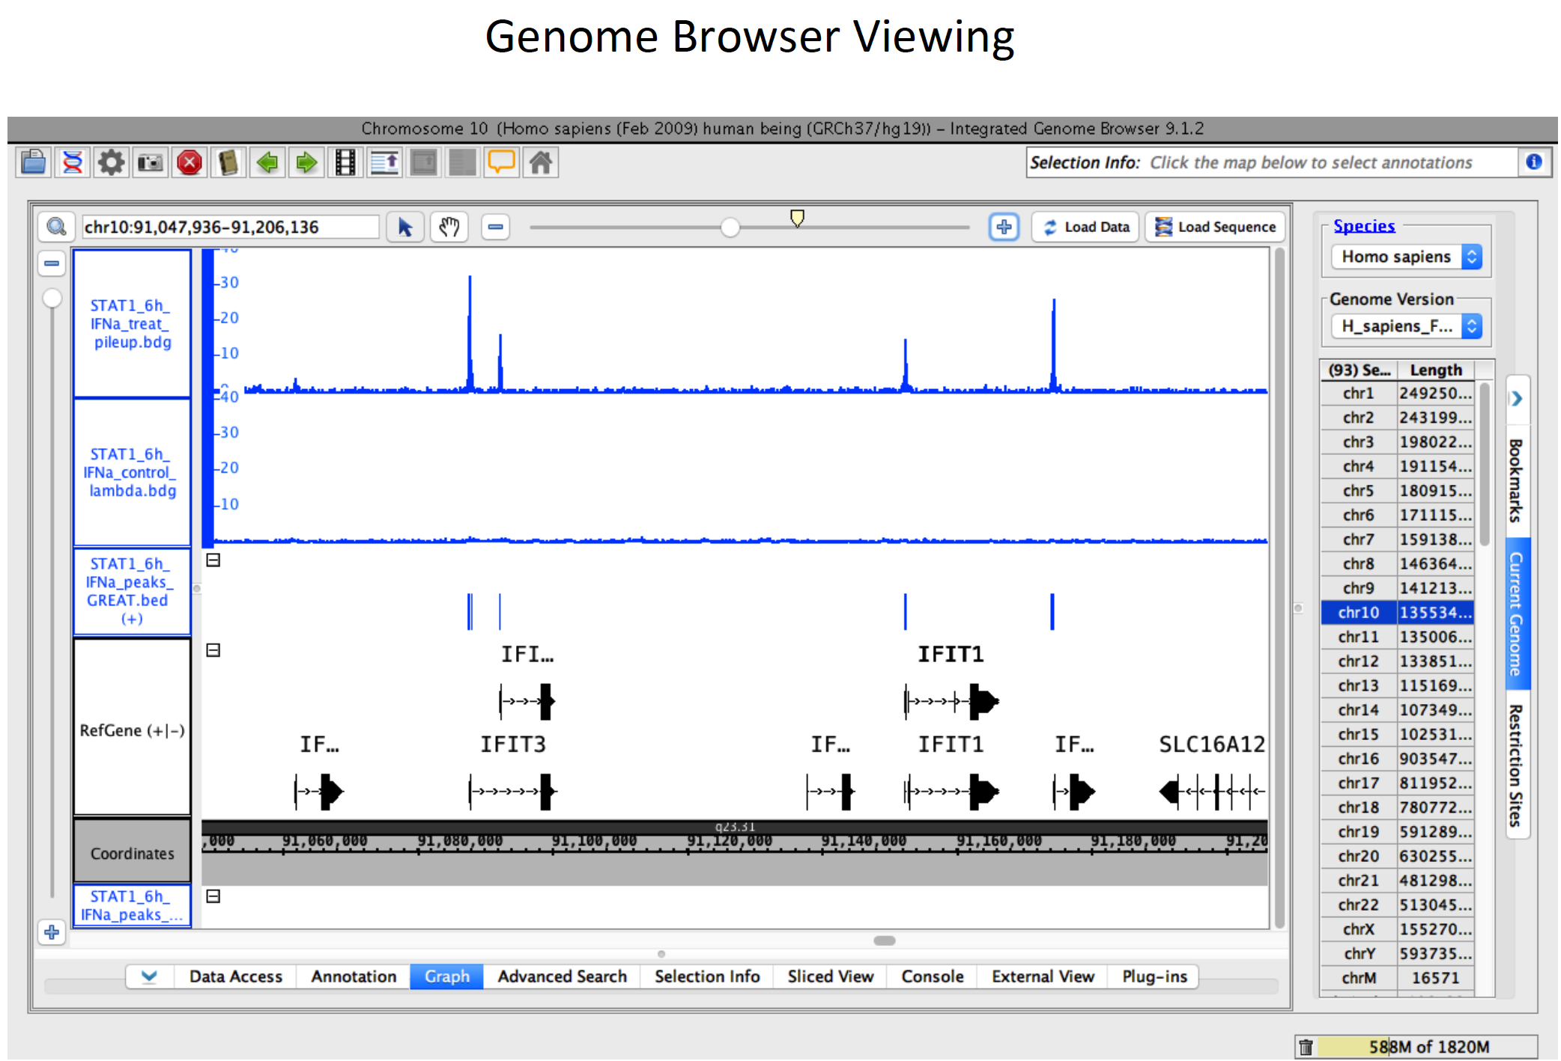
.bdg, .bam, .bigwig, .bed

Slide 33
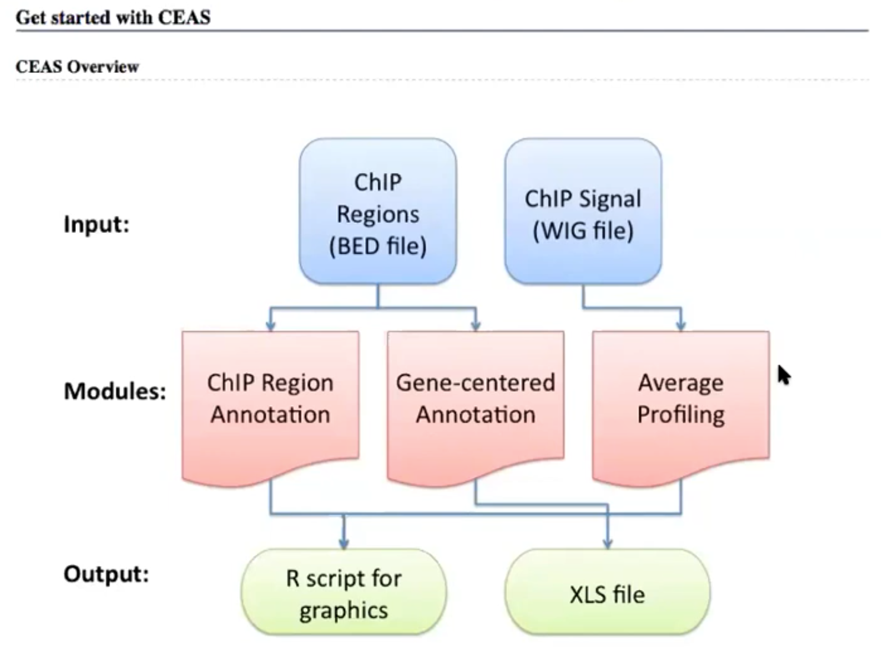
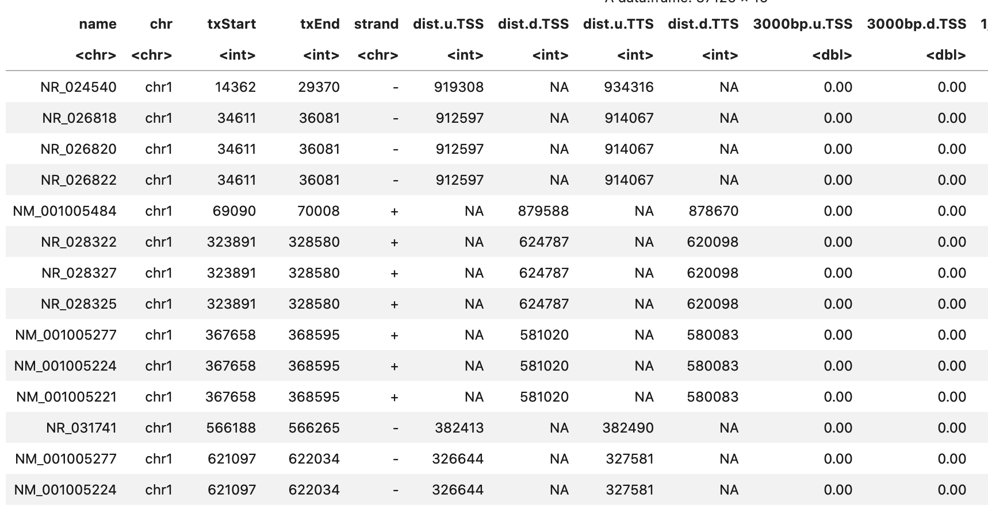
CEAS peak annotation
Relationship between genes and peaks
https://www.youtube.com/watch?v=JYBP5BpRfTM

Slide 34
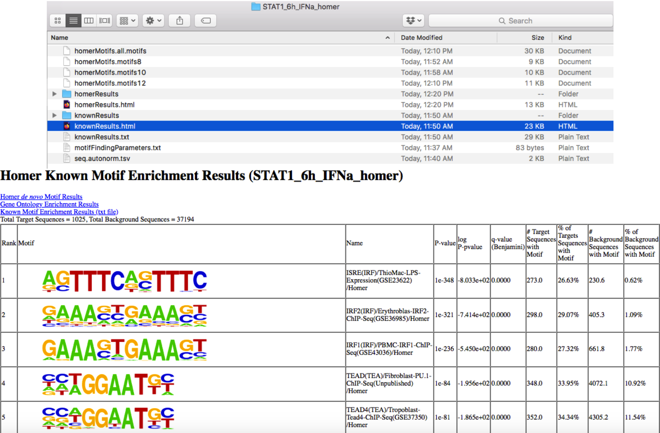

Slide 35
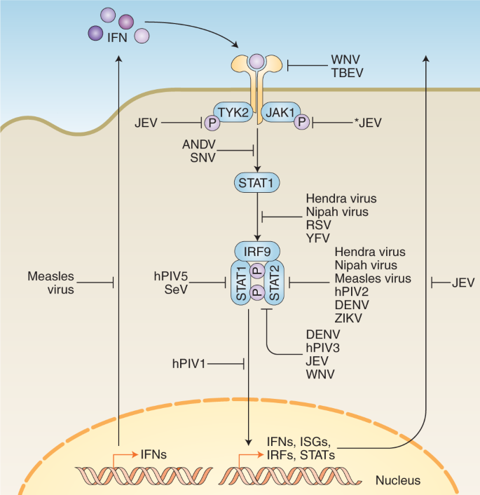
Sample data: the effect of Interferon ⍺ on STAT1 binding
Samples
STAT1 30 mins
STAT1 6 hours
Input (INP) 30 mins
Input (INP) 6 hrs

Slide 36
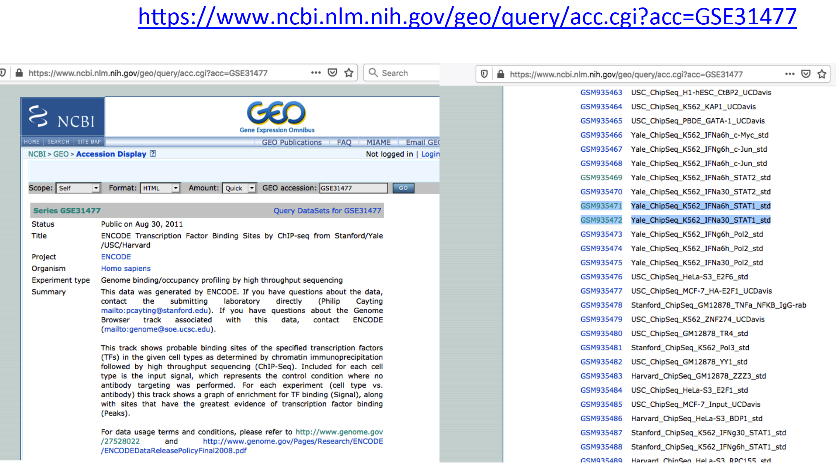

Slide 37
Part II, ChIP-seq analysis

Slide 38
Reference
Bulk RNA-seq
The pipeline and dataset 1
https://github.com/UMMS-Biocore/RNASeqTutorial/blob/master/RNASeqTutorial.pdf
Dataset 2 https://bioinfo.umassmed.edu/index.php?p=35#p1e3
Cluster profiler
https://yulab-smu.top/clusterProfiler-book/
Chip-seq
The pipeline, https://www.youtube.com/watch?v=JYBP5BpRfTM
DiffBind, https://www.youtube.com/watch?v=fa9sw3QqfWQ

Slide 39
Summary
Single cell RNA-seq (day 1)
Generate FASTQ from bcl files
Cellranger count
Pipelines for QC and dimension reduction
Trajectory inference through RNA velocity
Regulatory network analysis with SCENIC
Bulk RNA-seq (day 2)
Alignment using RSEM and Tophat
Normalization and differential expression via DESeq2
ChIP-seq
Alignment by Bowtie2
Peak calling with MACS2
Differential Peak calling using Homer
Peak annotation with CEAS
TF binding motif analysis

Slide 40
Additional reference
General tips for learning bioinformatics
https://github.com/zhuy16/learning_notes
single cell rna-seq
https://github.com/niaid/single-cell-RNA-seq
Gene Regulatory Networks
https://github.com/niaid/Gene_Regulatory_Networks
Functional annotation with clusterProfiler
https://github.com/zhuy16/FunctionalAnnotation_notebooks

